Slide 1

The Protocol Protectors
ENHANCING VOIP PERFORMANCE AND SECURITY USING WIRESHARK
21BLC1349-HARSHAVISHAL.S
21BLC1254-SOURISH.J.S

Slide 2

PROBLEM STATEMENT
Design and implement a network monitoring and troubleshooting solution using Wireshark to ensure optimal performance and security of the network.
The solution should enable VoIP call analysis, traffic capture, network troubleshooting, detection of unusual traffic indicative of malware or trojan activity, and identification of ARP poisoning attacks.

Slide 3


AIM
Enhancing VoIP Performance: Network Protection and Troubleshooting
Detection of Unusual traffic and identification of malware or trojan activity(IDS)

Slide 4



Wireshark
Wireshark is a popular and powerful open-source network protocol analyzer. It is widely used for network troubleshooting, analysis, and monitoring purposes. With Wireshark, you can capture and examine network traffic in real-time or analyze previously captured traffic.
Wireshark allows you to inspect the details of individual packets within a network communication. It supports a wide range of network protocols, making it versatile for analyzing various types of traffic, including VoIP protocols like SIP, RTP, and others.

Slide 5
IMPLEMENTATION OF VOIP
Phase 1
Phase 2
Phase 3
Use Wireshark's built-in VoIP analysis features to monitor call quality, identify potential issues.
Capture SIP traffic
Analyze RTP traffic

Slide 6
UNUSUAL TRAFFIC DETECTION
Phase 1
Phase 2
Phase 3
Capture network traffic and analyze it for signs of unusual or malicious behavior.
Look for patterns such as large amounts of traffic
Utilize Wireshark's protocol dissectors and statistical tools to identify anomalies and flag potentially malicious traffic.

Slide 7




REFERENCES
REFERENCES 1
Learn Wireshark: A Definitive Guide to Expertly Analyzing Protocols and Troubleshooting Networks Using Wireshark by Lisa Bock, 2022
REFERENCES 2
Practical Packet Analysis: Using Wireshark to Solve Real-world Network Problems by Chris Sanders, 2006
REFERENCES 3
Adam's Guide to Packet Capture Analysis Using Wireshark: Volumes 1 And 2 by Adam Streeter

Slide 8
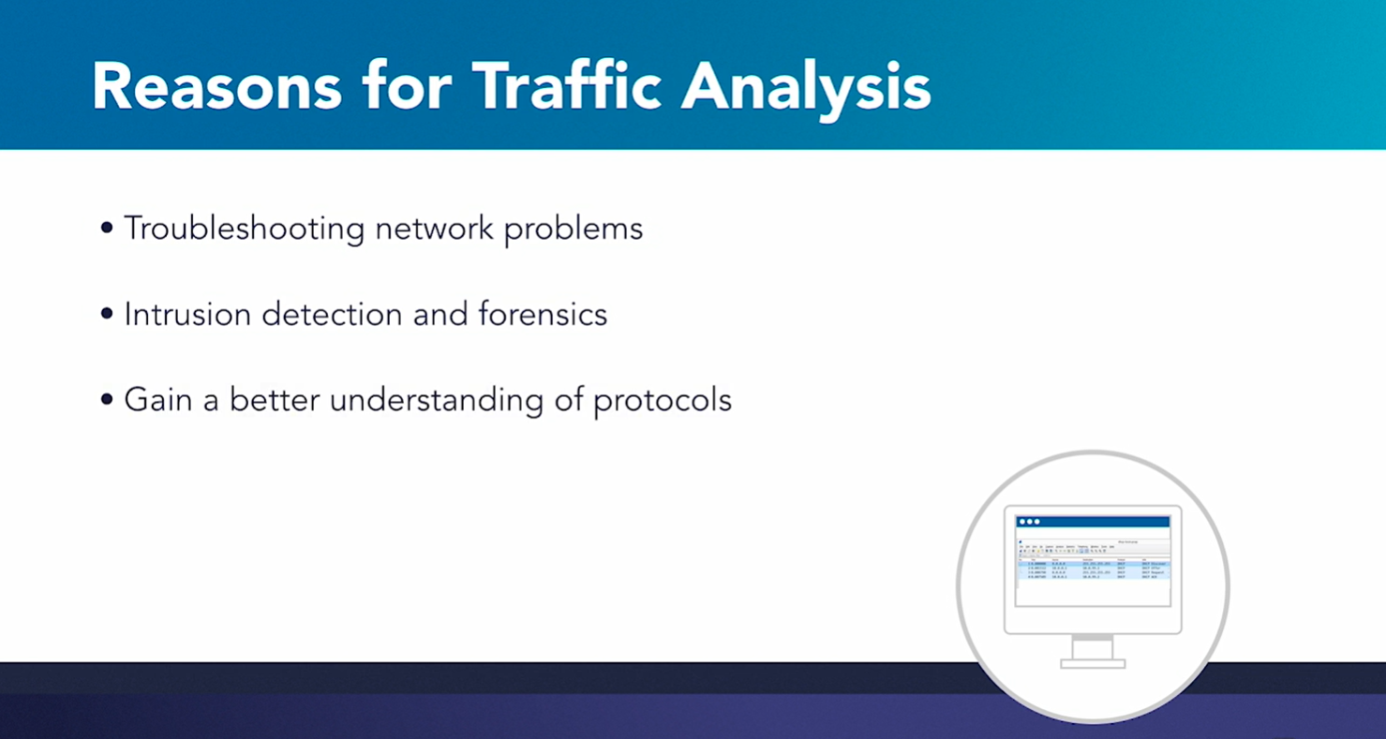

Slide 9
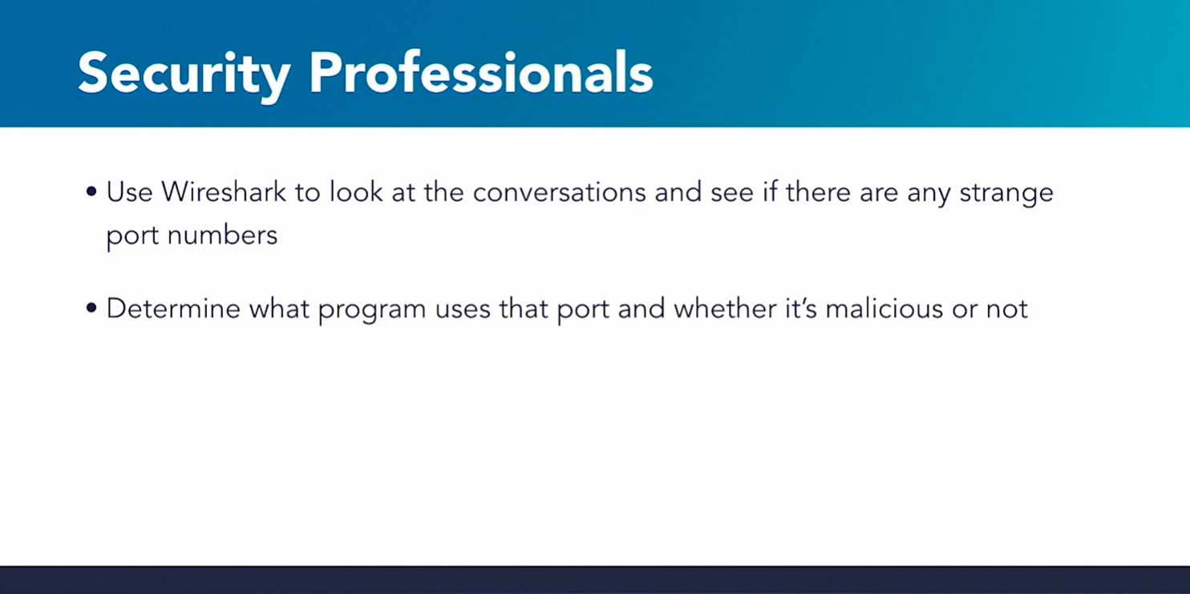

Slide 10
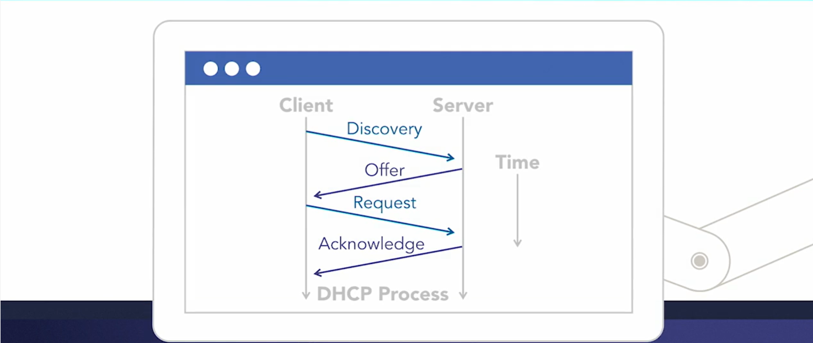

Slide 11
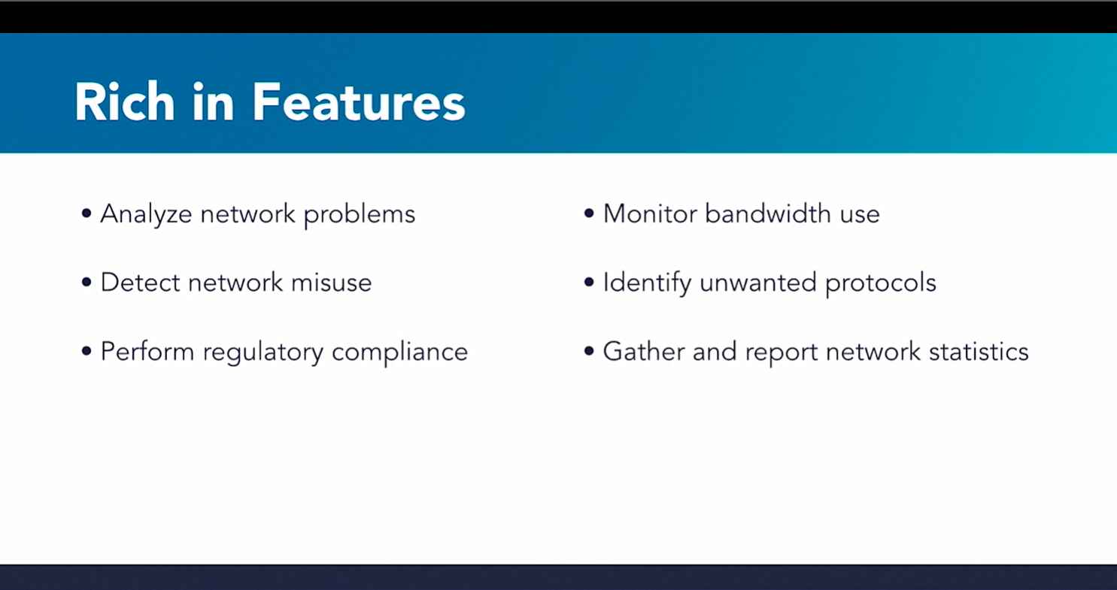

Slide 12
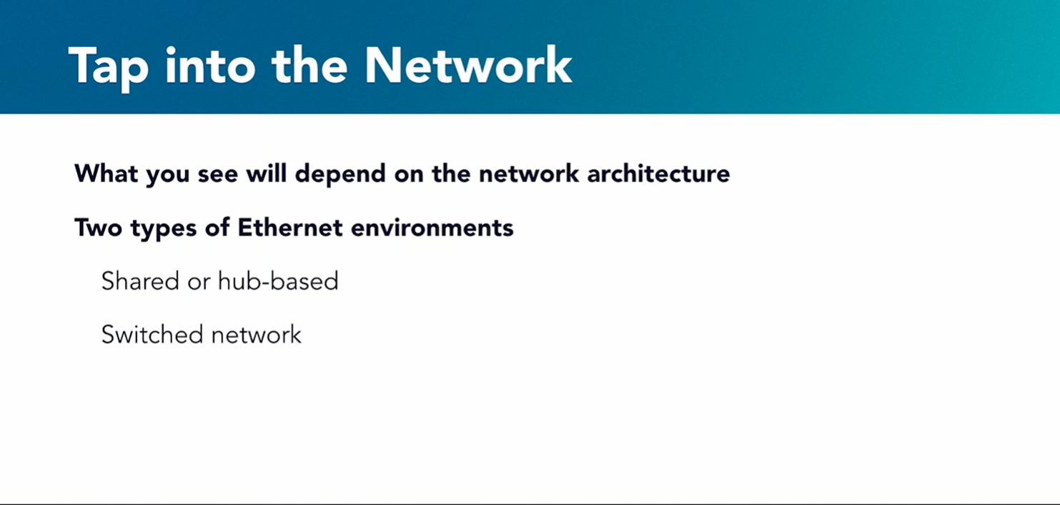

Slide 13
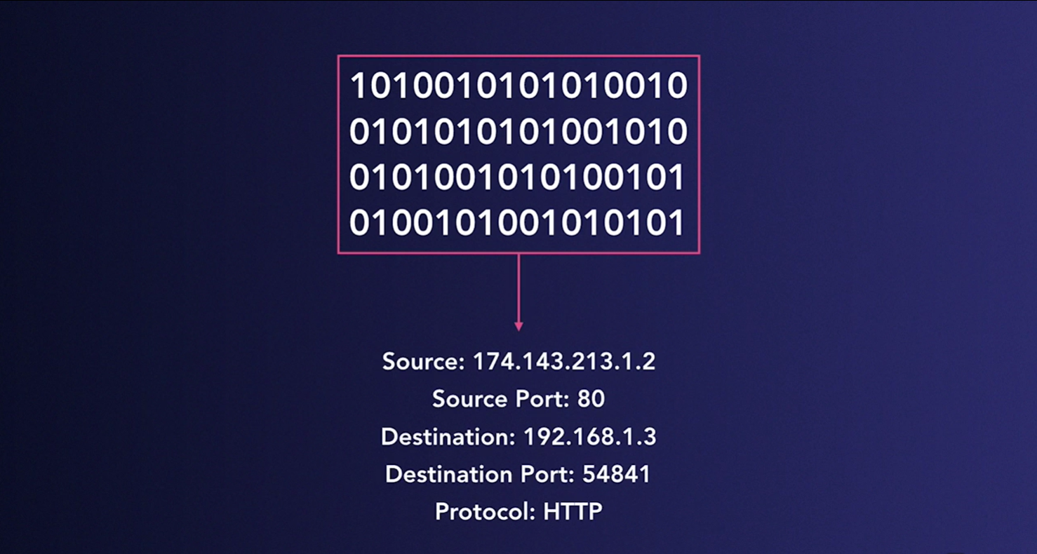
Packet Analysis Tools convert those bit into a readable form for analysis

Slide 14
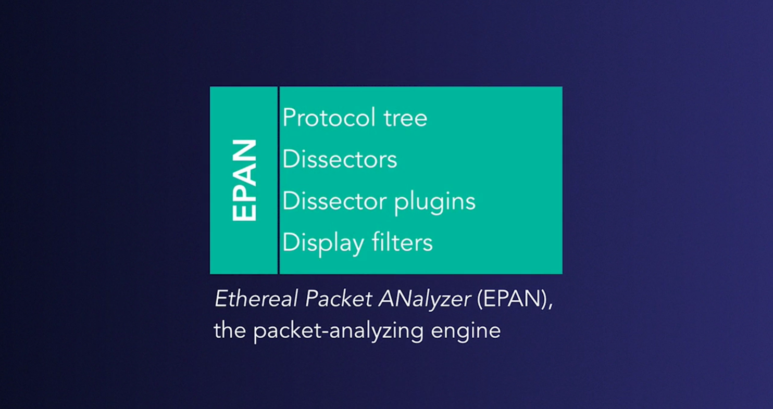

Slide 15
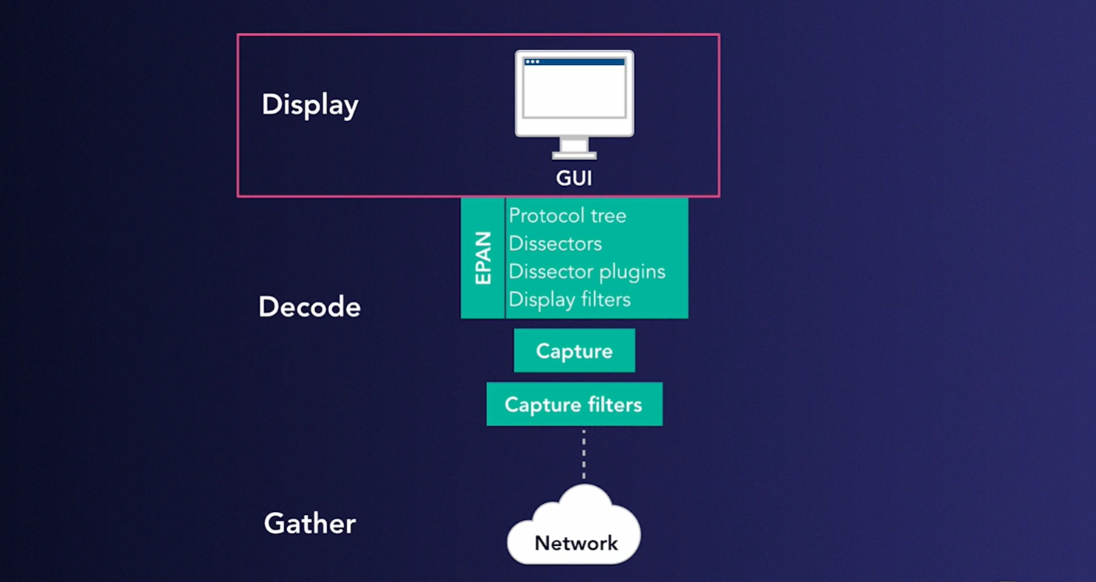

Slide 16
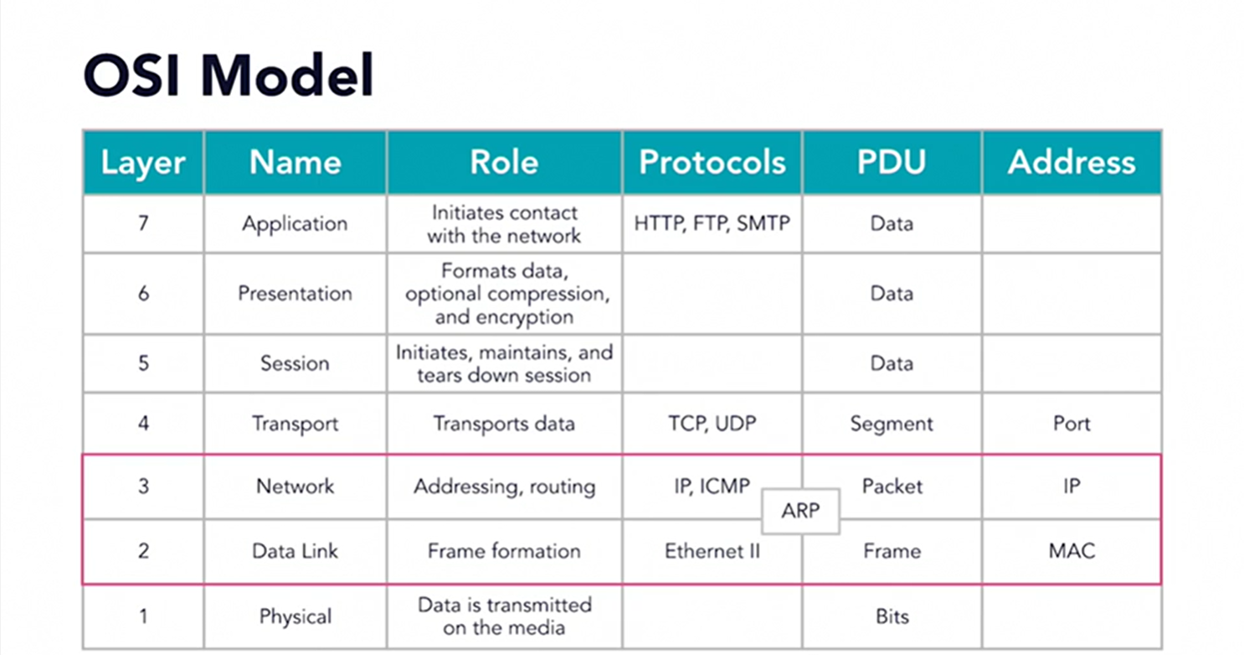

Slide 17
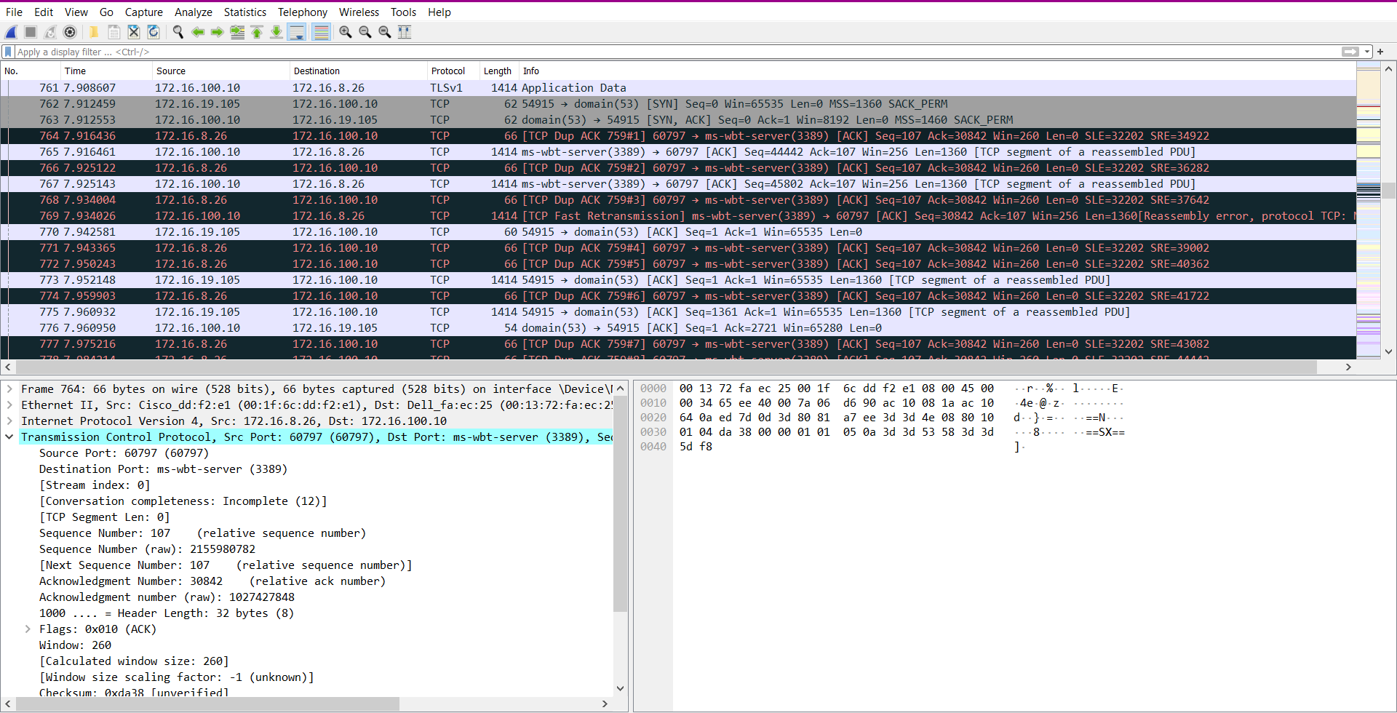
Network Latency Issues

Slide 18
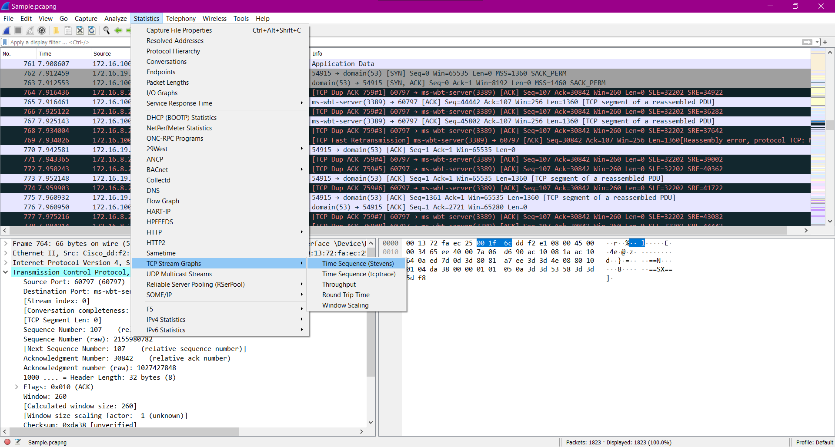

Slide 19
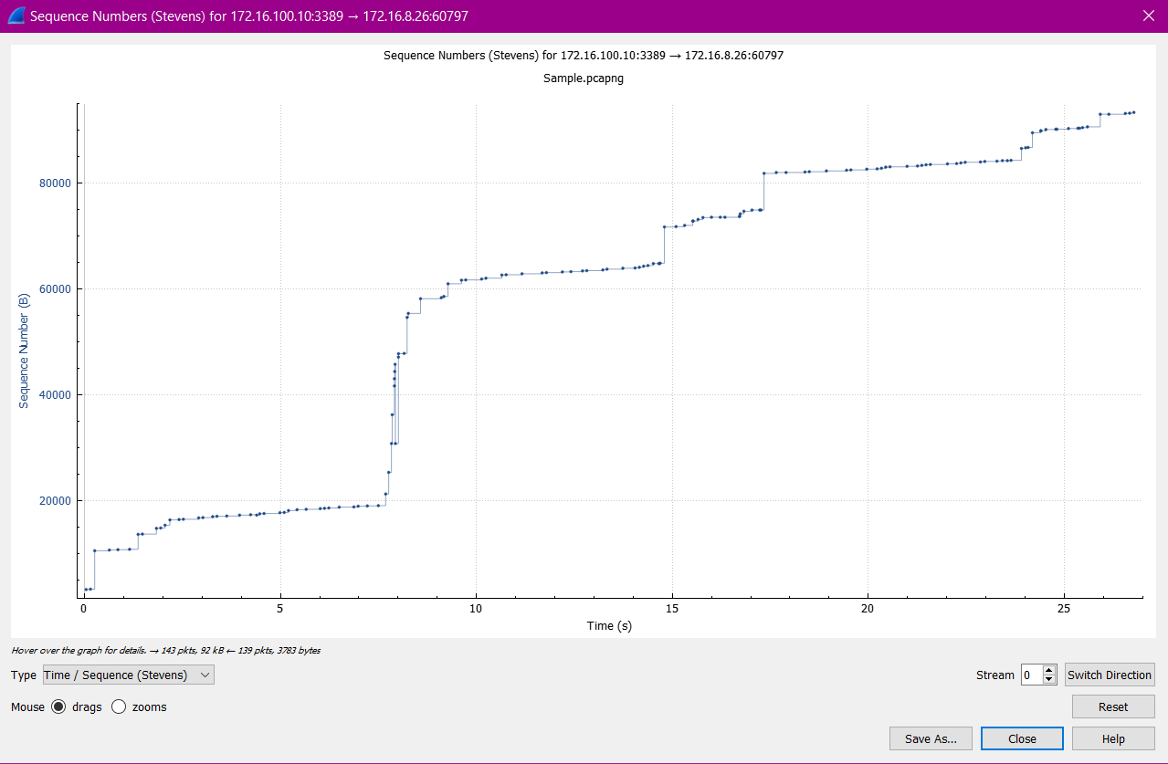
TCP Stream of Stevens Graph
Analysing Stream 0 ( Destination to Source)

Slide 20
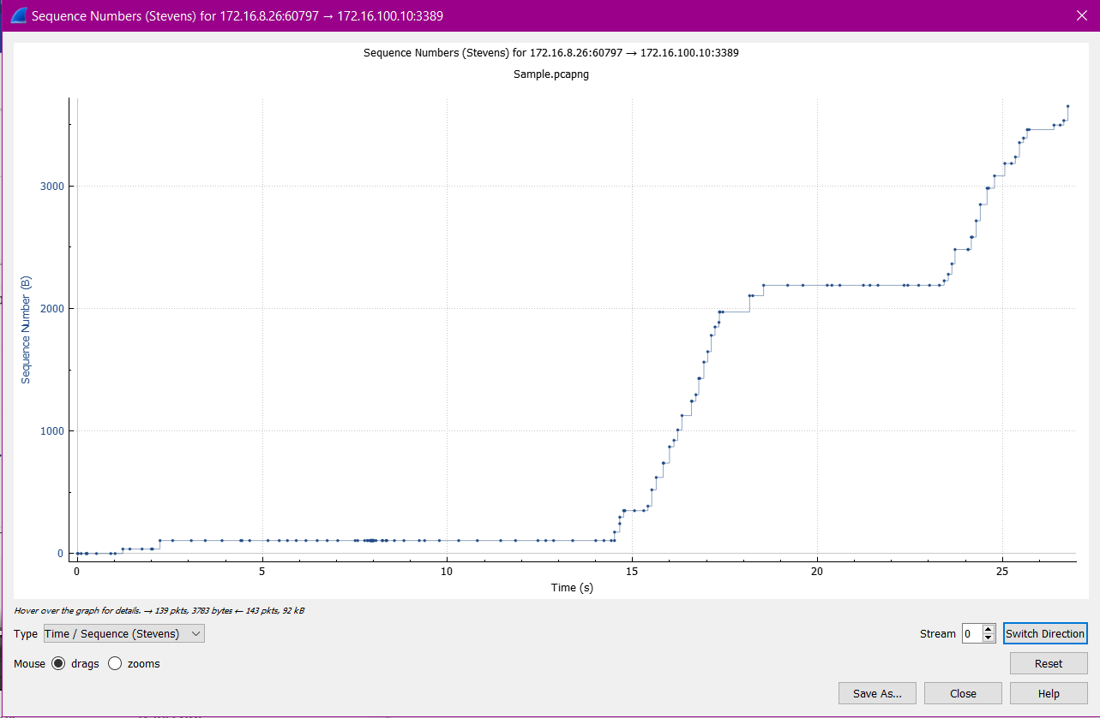
Source to Destination

Slide 21
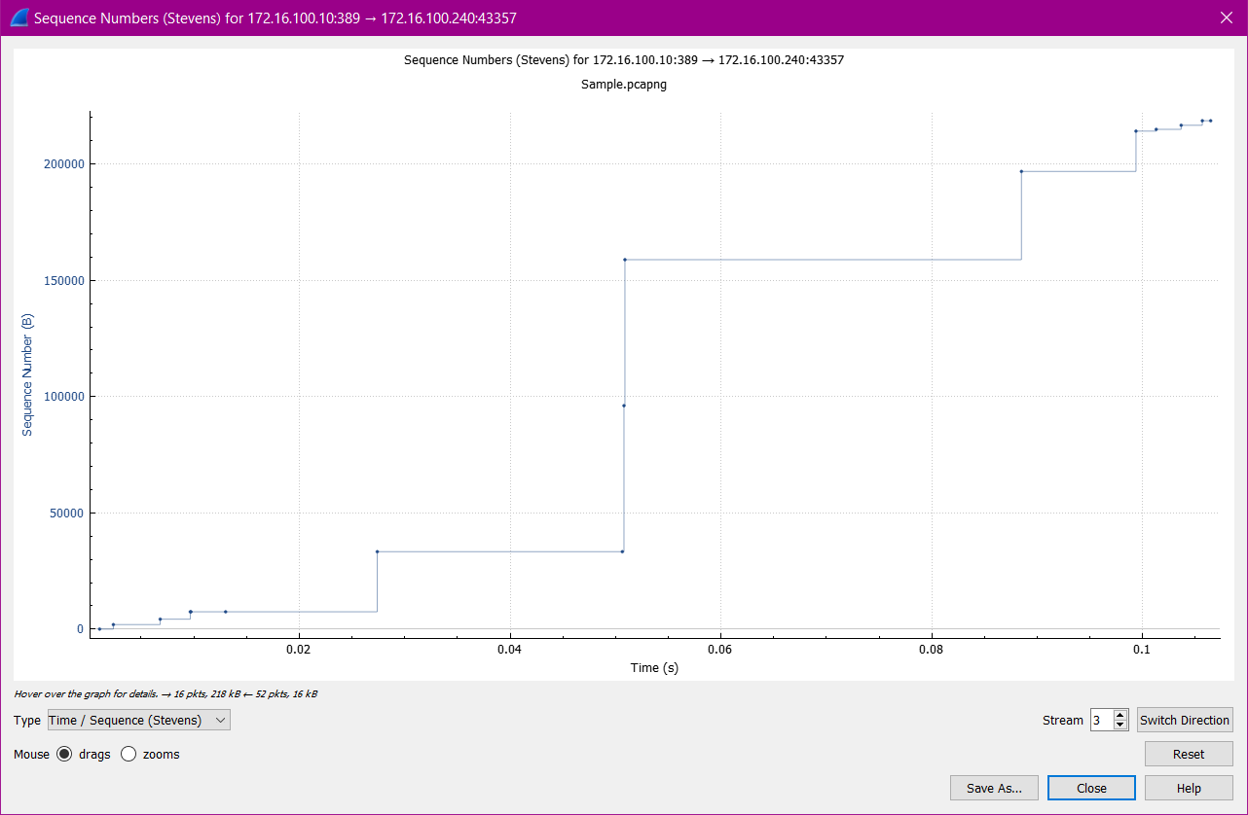
We can see some gaps and delays in transmission that is going to be adding the network latency issues.
Now we have switched to stream 3 ( Destination to Source)

Slide 22
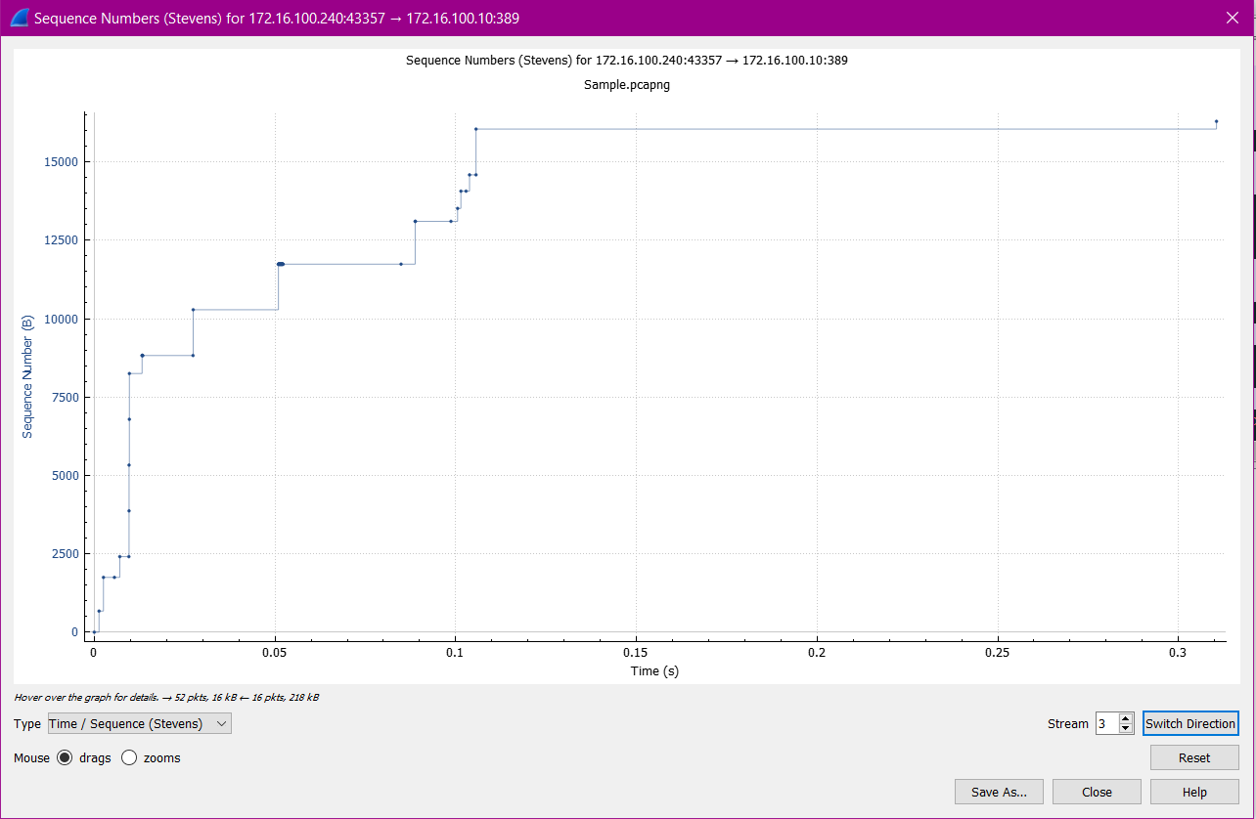
Source to Destination

Slide 23
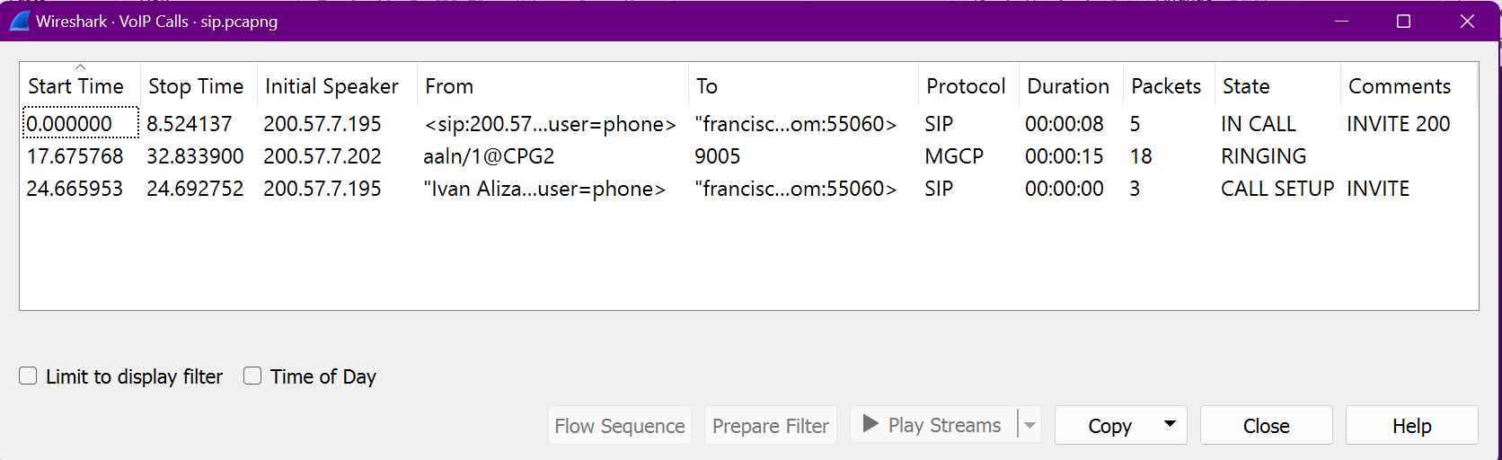
VOIP CALLS

Slide 24
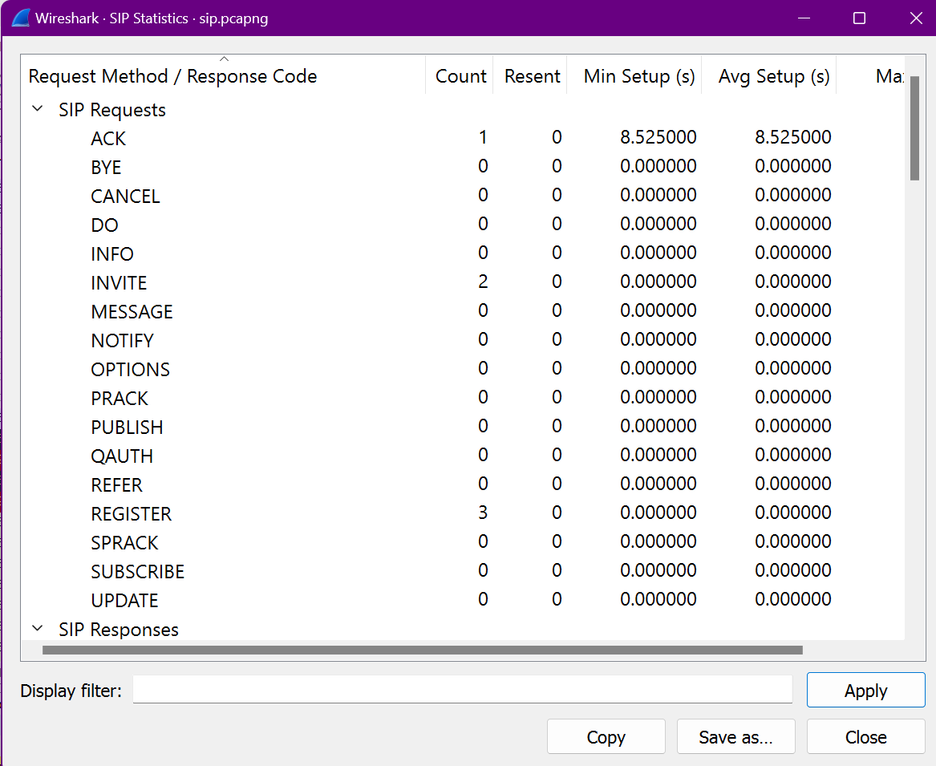
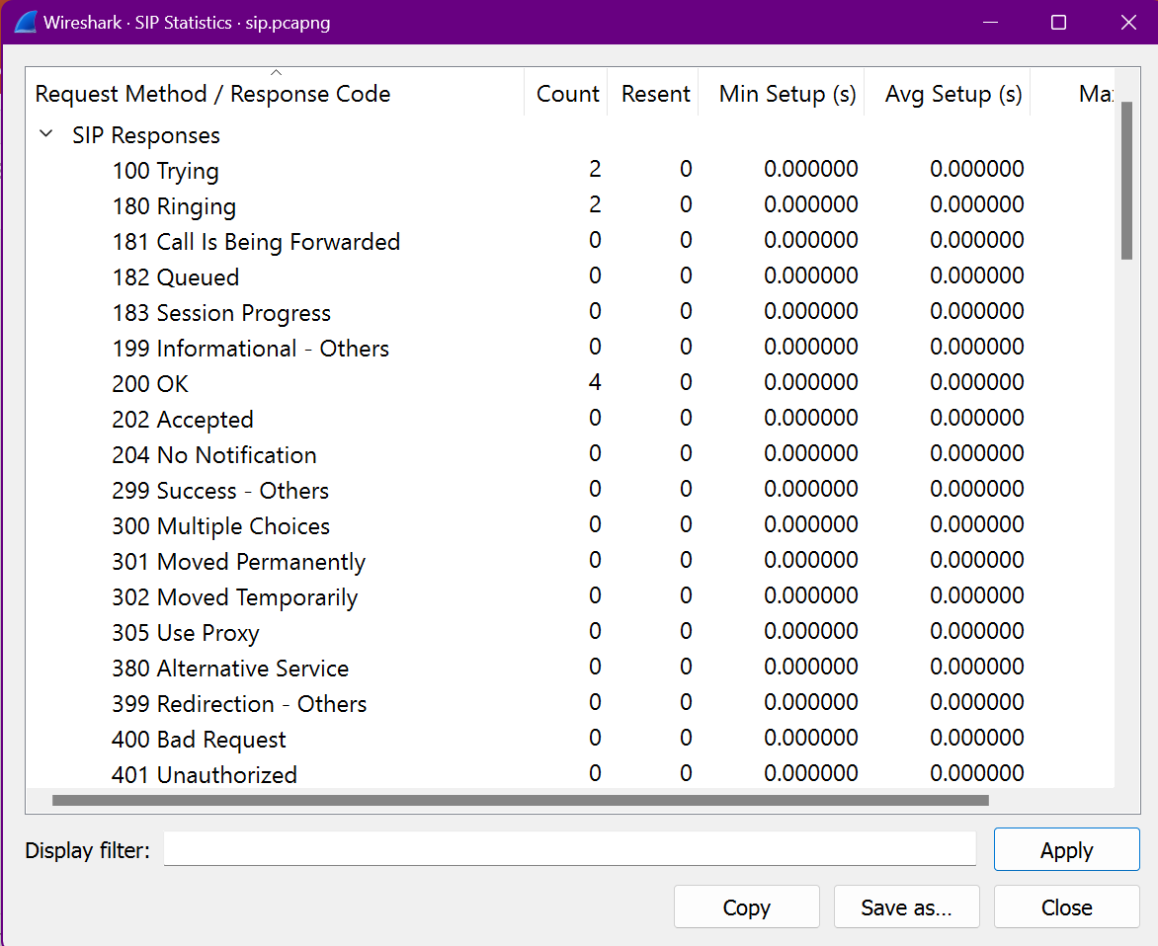

Slide 25
TROUBLESHOOTING VOIP
When examining a voice-over-IP call, Wireshark does a great job of dissecting a number of the common protocols. Now, when you're looking at the call, there's a number of different states it recognizes. You might see it in the
• CALL SETUP state, or
• RINGING, or
• IN CALL, when both parties are connected.
• It could be CANCELLED, or COMPLETED and that means both parties have disconnected.
• It could be REJECTED, or in some cases, it might come up as UNKNOWN.
That's because Wireshark really didn't understand how to interpret the state. When we take a look at an example of a couple of calls where you can see the different states as we go deep in analyzing the call.

Slide 26
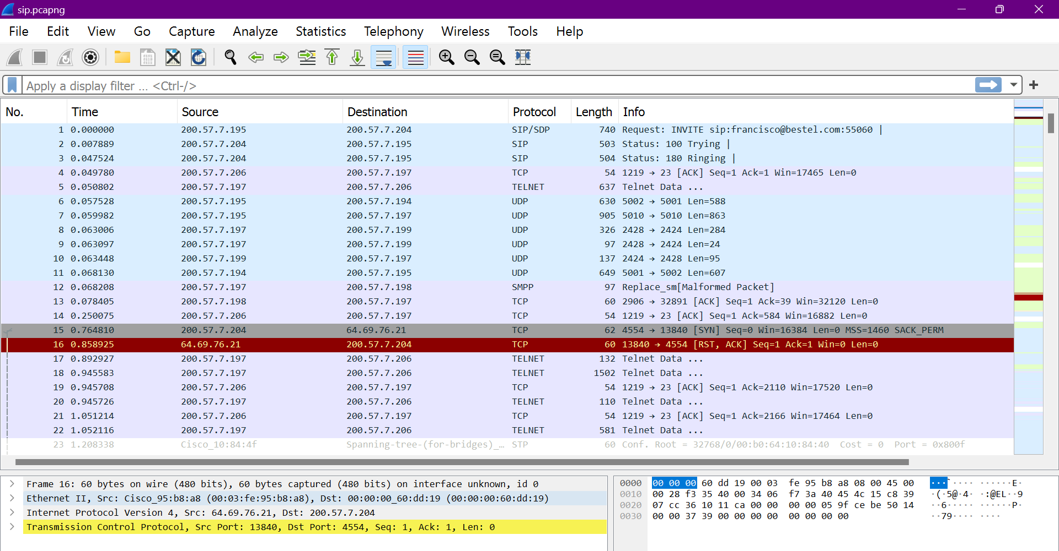

Slide 27
Details like, the Start Time and Stop Time, Min and Max Jitter, etc. You can see what the Initial Speaker's IP address is and where it's from, along with where it's going to. And you can see the Protocol. Those would be the ones that are supported and how long it lasted, along with how many Packets and there you would see the State. In this case, we see IN CALL, RINGING and CALL SETUP, along with Comments.
Now, we'll see one more Sample Capture,

Slide 28
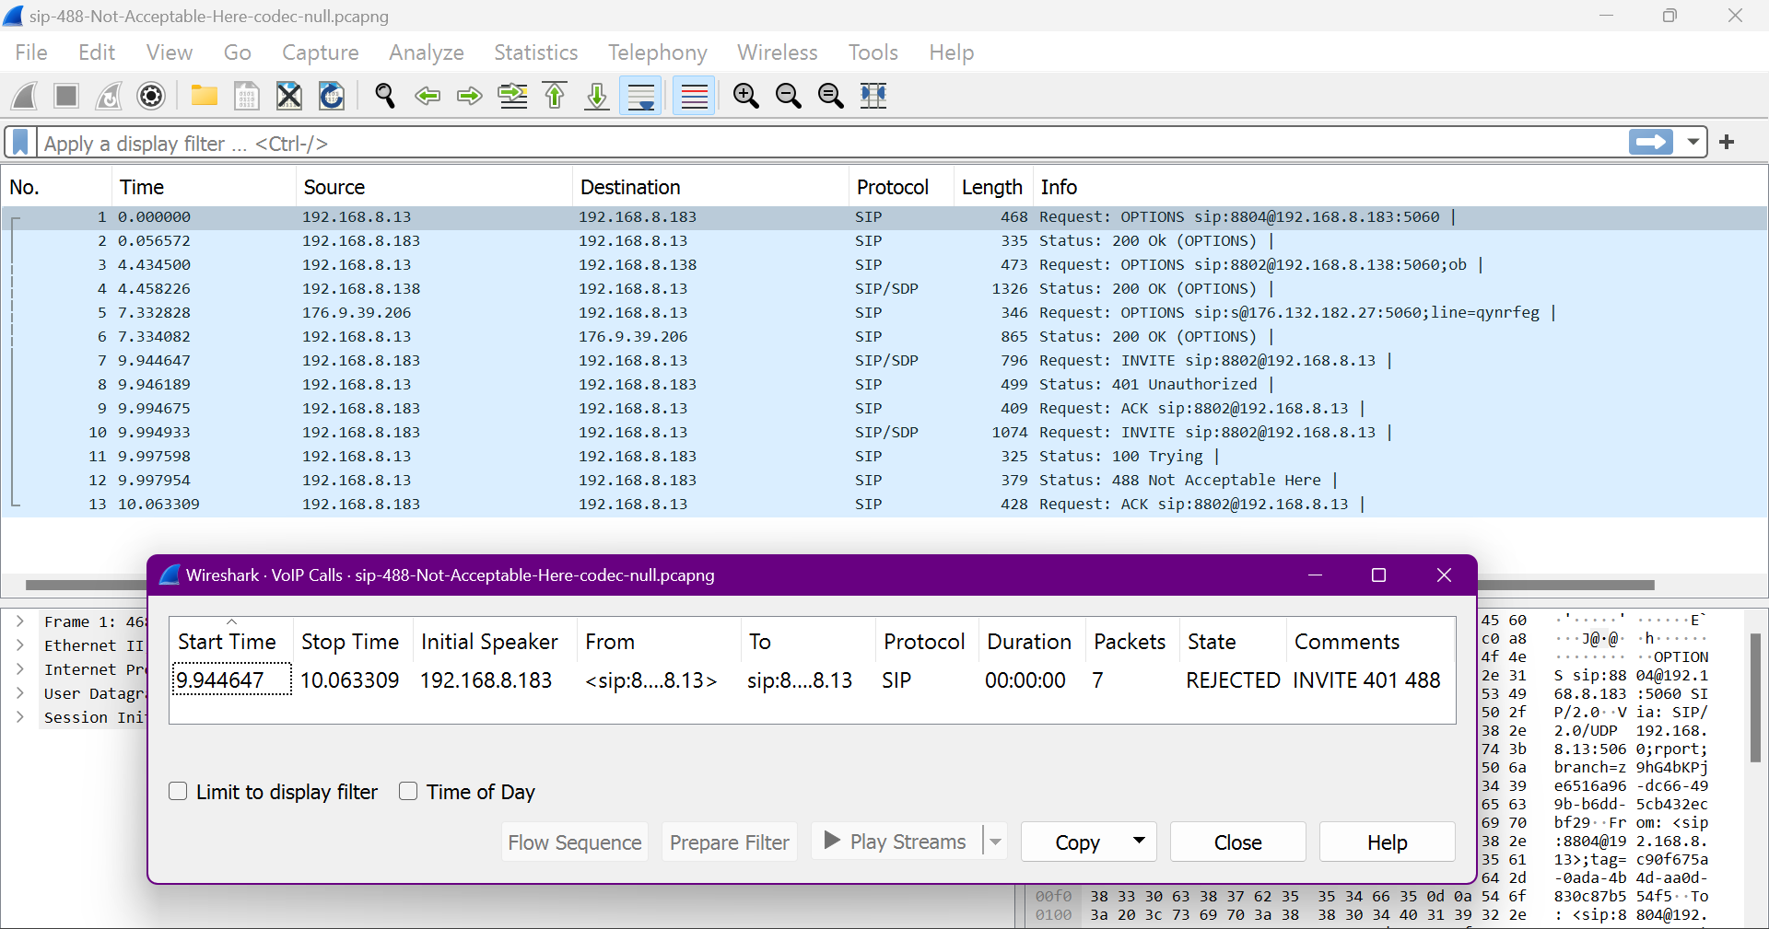
In this we see the State, REJECTED. Now, when a REJECTED call arises, you might need to do some troubleshooting. Wireshark has the capability of dissecting many different protocols, along with recognizing different States in a VoIP call.

Slide 29
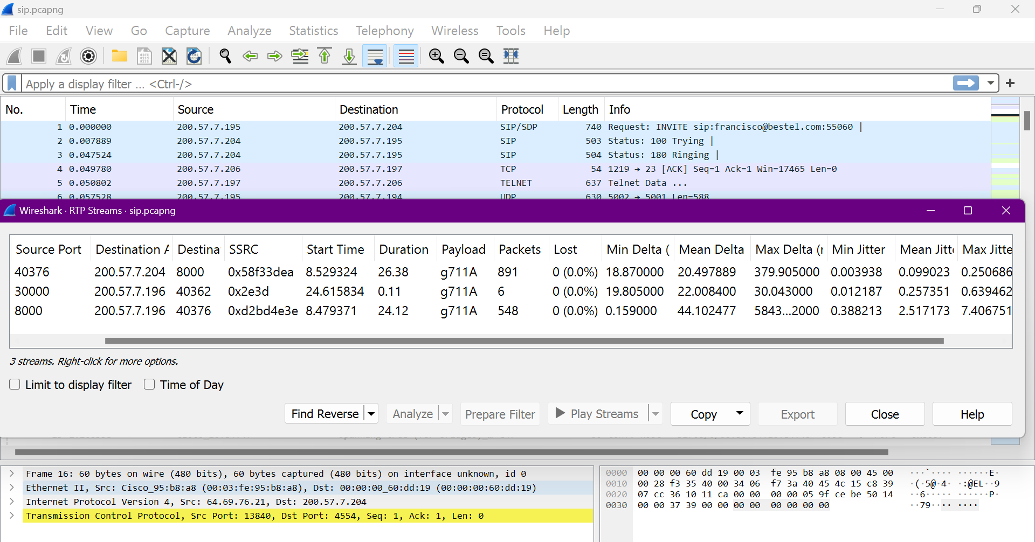
ANALYZING RTP STREAM & JITTER
When evaluating an RTP stream in Wireshark, there are several ways to view the data. In this segment, we'll isolate and analyze the RTP streams. For this segment, we'll use the first sample pcapng file. So we'll go into Telephony and then RTP. And here we see RTP streams, but the other two are dimmed out. Well, let's just select that, RTP streams, and here we see three streams. Now we know that there are more than three streams.

Slide 30
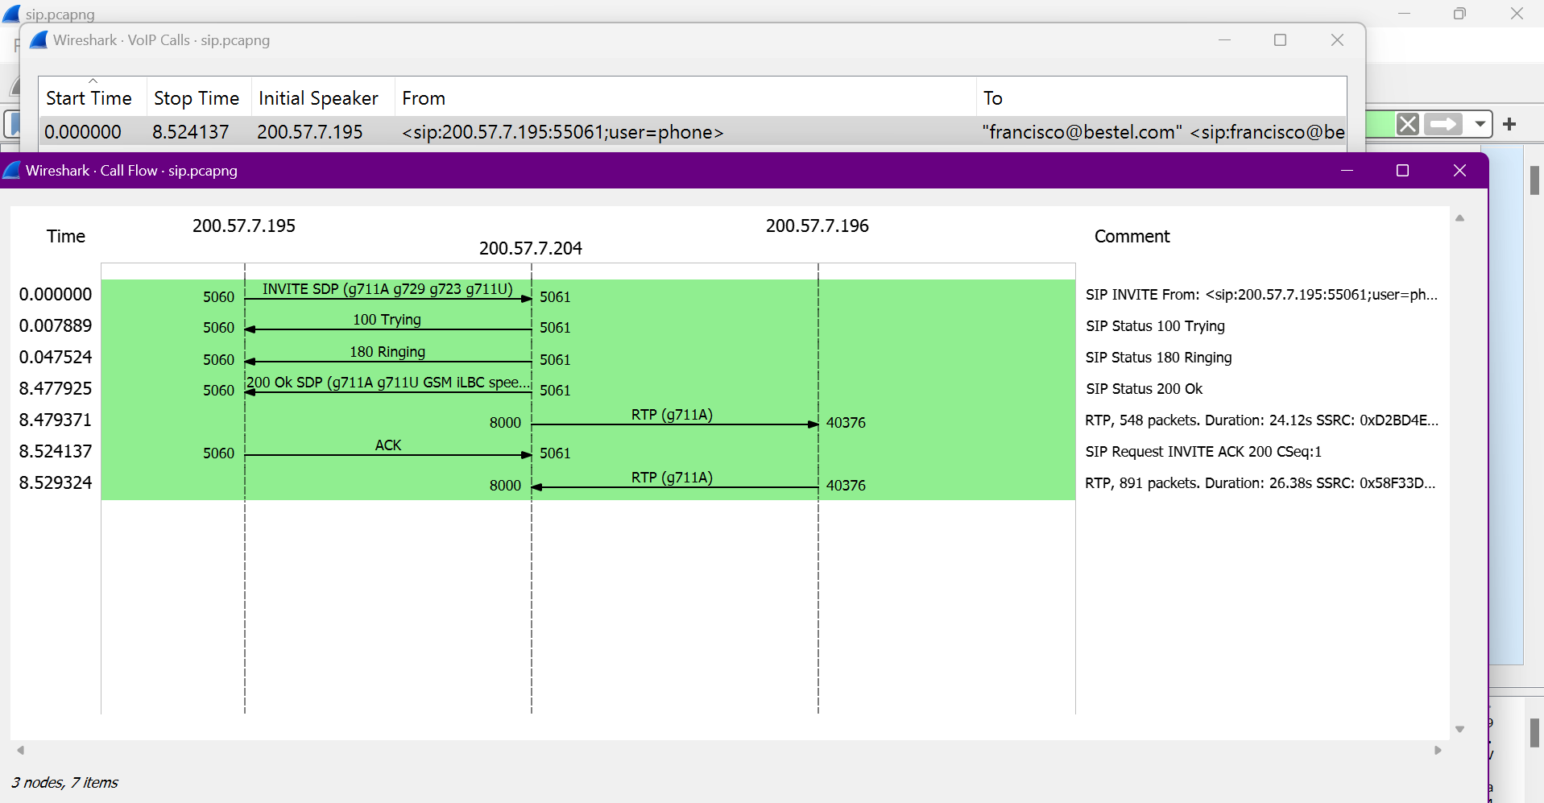

Slide 31
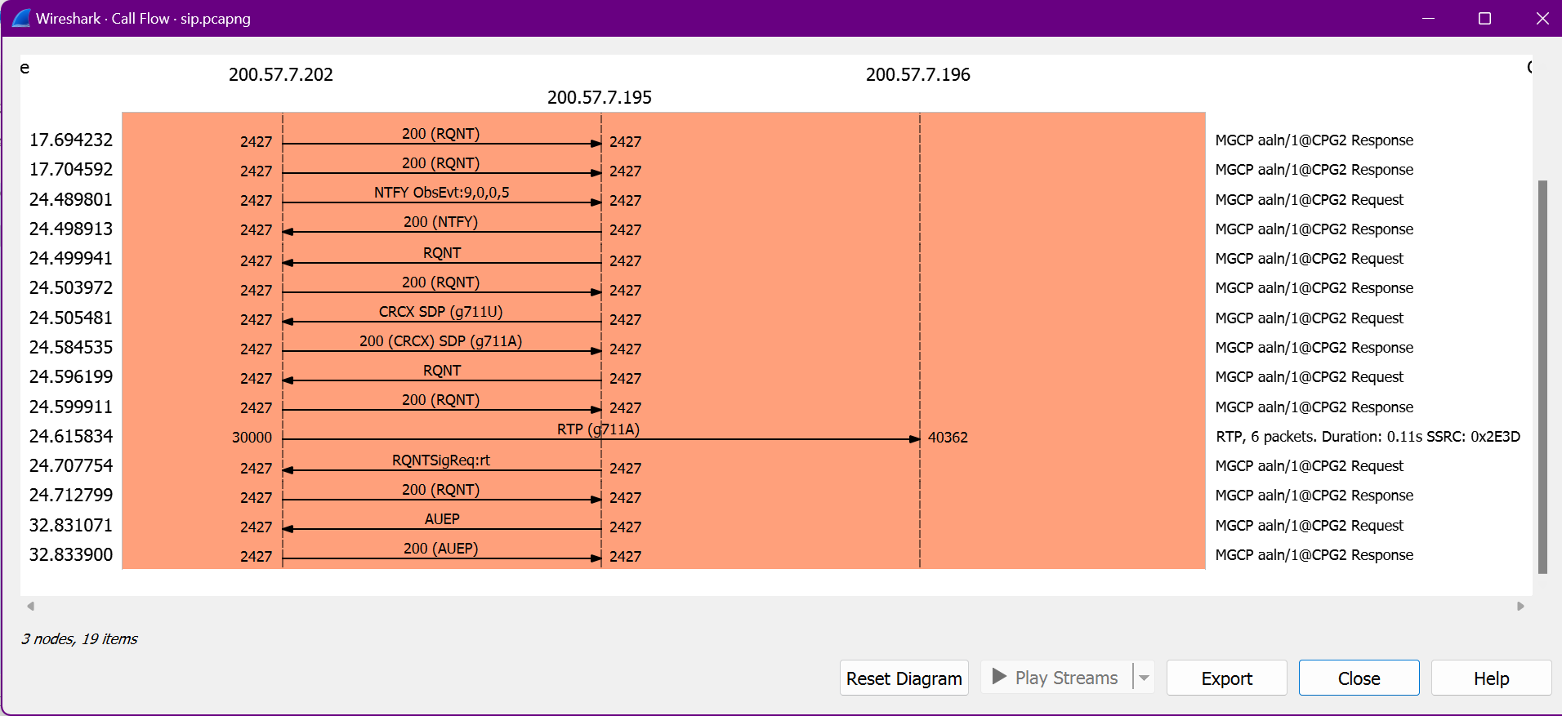

Slide 32
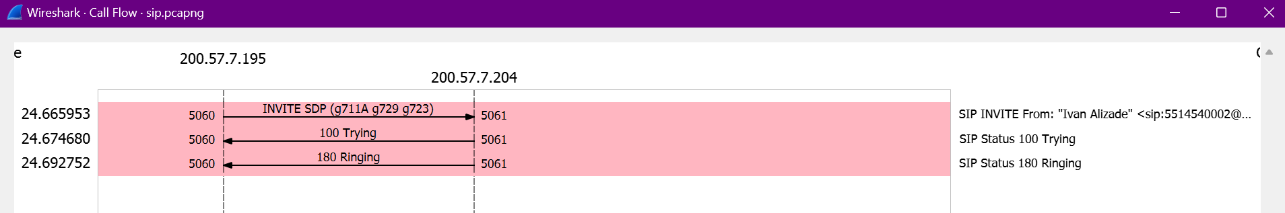

Slide 33
So, we have to complete a couple of tasks. In this case, we're going to use the feature decode as, specifically, we're going to go into the user datagram protocol using Source Port 4800. We can see that there is one at Frame 516. So go to Specified Packet, 516 and then press Enter. Now once there, right click and say Decode As. We are going to type RTP and it will force it to decode as RTP. Select RTP and now it recognizes it as RTP.

Slide 34
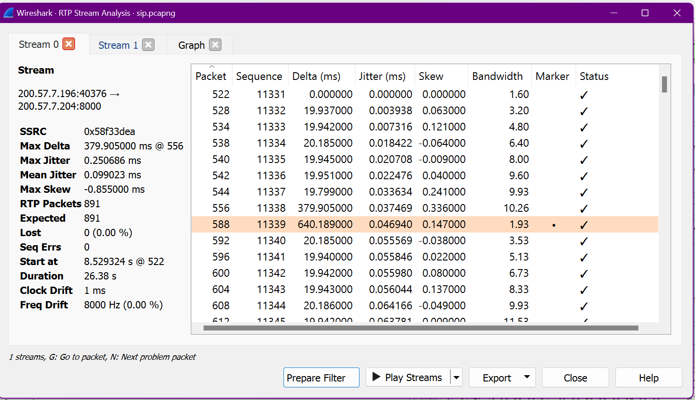

Slide 35
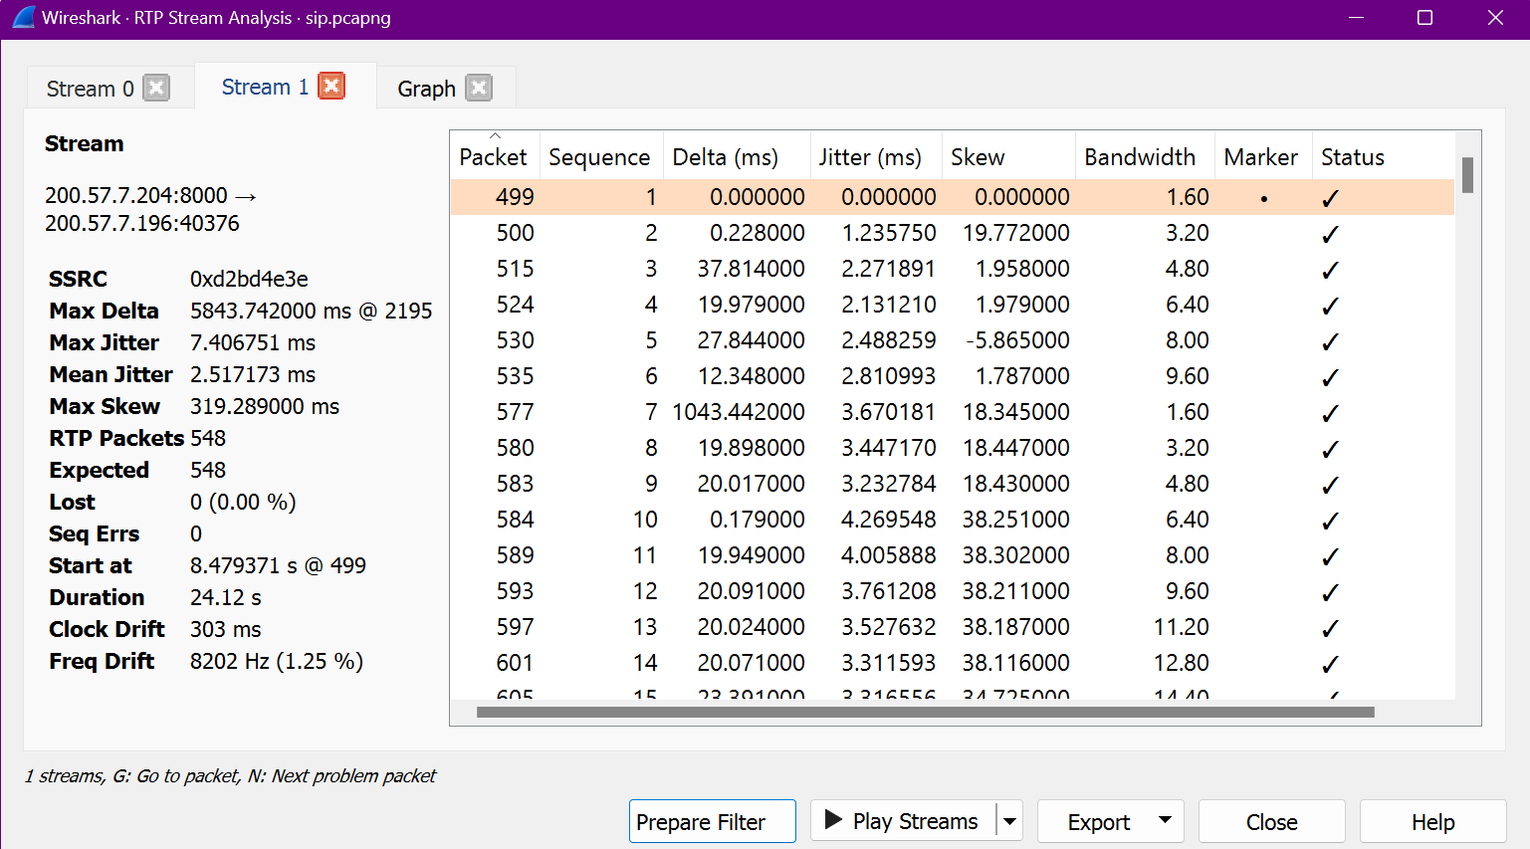

Slide 37
When the display filter RTP is put on, we can view the streams. So go into Telephony and RTP. Now we can see the streams and the other two options. Select the first one. Now from the streams, select any two and click Analyze. It gives us a nice snapshot of that stream and we can see the source address, port, destination address and port, and here we see the synchronizing source. We can see the RTP packets, lost packets and maximum jitter. As for Jitter, anything under 30 milliseconds is considered. We can have a look at the graph and some other statistics.

Slide 38
RECOGNIZING JITTER
There are times when it's essential to do an RTP stream analysis to determine trouble spots on the network. Go to analyze and enabled protocols and type RTP, and then down below you'll want to check RTP over UDP. This will enable Wireshark decode an RTP over UDP stream. Now, we know that ideally jitter should be below 30 milliseconds. However, at times the connection becomes unstable and jitter will start to creep up. Go to the display filter and type RTP. Then, go to telephony, RTP and RTP streams.
Now, there are two streams and here we see the max jitter. When we see the two values, we see the lower value and then the second value. Now depending on what's happening on your network, baseline or snapshot that call because it might change over time to see what's happening on your network

Slide 39
Protocol Hierarchy
"Protocol","Percent Packets","Packets","Percent Bytes","Bytes","Bits/s","End Packets","End Bytes","End Bits/s","PDUs"
"Frame",100,2028,100,1441921,288747.27131119964,0,0,0,2028
"Ethernet",100,2028,1.969039912727535,28392,5685.549019029184,0,0,0,2028
"Internet Protocol Version 6",95.51282051282051,1937,5.373387307626423,77480,15515.509227753635,0,0,0,1937
"User Datagram Protocol",17.99802761341223,365,0.20250762697817704,2920,584.735247096549,0,0,0,365
"QUIC IETF",16.222879684418146,329,10.692125296739558,154172,30873.220039509983,329,138166,27667.98977751431,352
"Data",1.7751479289940828,36,0.28191558344735945,4065,814.0235546052985,36,4065,814.0235546052985,36
"Transmission Control Protocol",77.41617357001972,1570,80.84555256494635,1165729,233439.32700774414,669,104110,20848.21458055538,1570
"Transport Layer Security",44.42800788954635,901,80.33741099547062,1158402,231972.0820914851,901,1068376,213944.21381918582,963
"Internet Control Message Protocol v6",0.09861932938856016,2,0.004438523331028538,64,12.816115004855867,2,64,12.816115004855867,2
"Internet Protocol Version 4",4.191321499013807,85,0.11789827598044553,1700,340.428054816484,0,0,0,85
"User Datagram Protocol",3.5996055226824457,73,0.0405015253956354,584,116.94704941930979,0,0,0,73
"Domain Name System",3.5996055226824457,73,0.336287494252459,4849,971.0209634147828,73,4849,971.0209634147828,73
"Transmission Control Protocol",0.591715976331361,12,0.3751939253260061,5410,1083.3622215042226,4,80,16.020143756069835,12
"Transport Layer Security",0.39447731755424065,8,0.35854946283464906,5170,1035.301790236013,8,5170,1035.301790236013,8
"Address Resolution Protocol",0.2958579881656805,6,0.011651123743949911,168,33.642301887746655,6,168,33.642301887746655,6

Slide 40
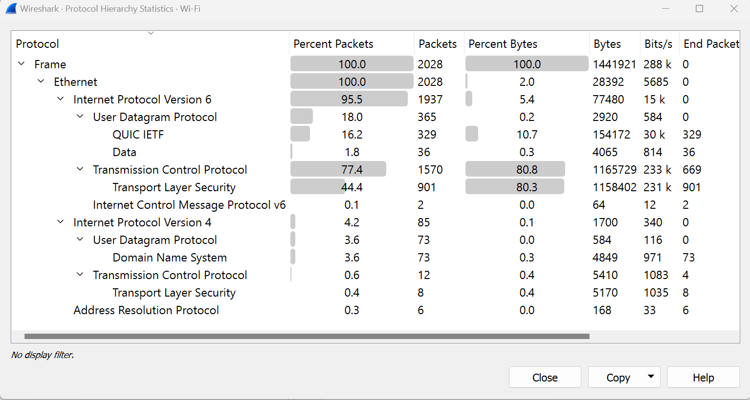
Protocol Hierarchy Image

Slide 41
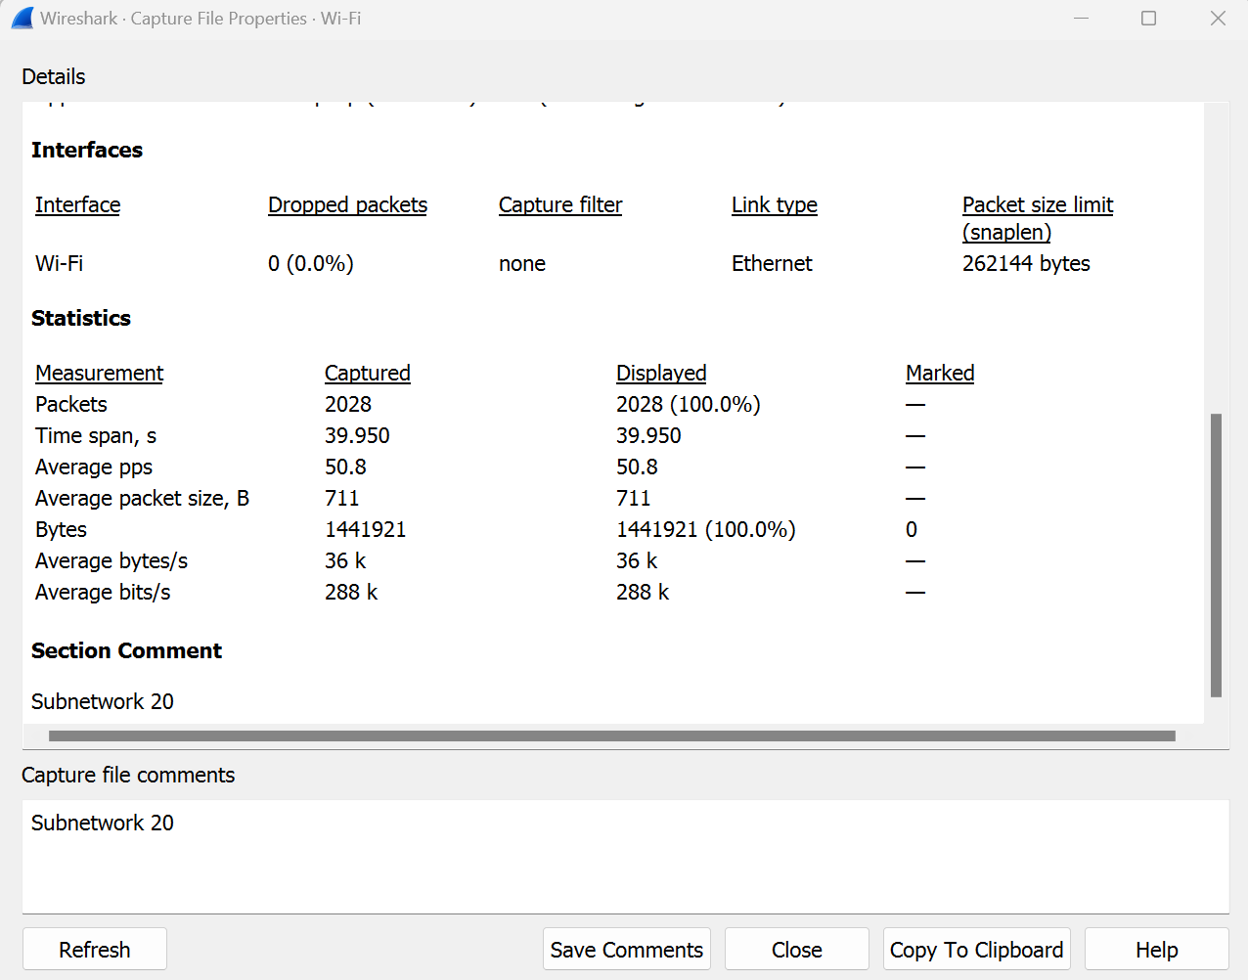
Statistics of packet captures of Subnetwork 20

Slide 42
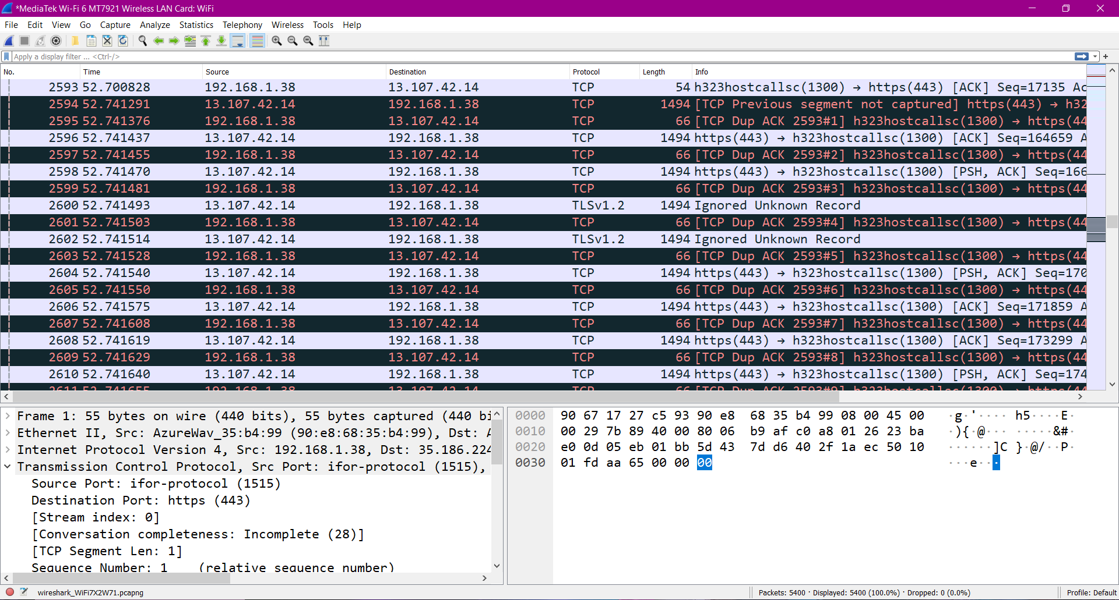
Examining a Capture (Retransmission of packets in a TCP)
There are some duplicate packets that has been discovered while examining the packet capture

Slide 43
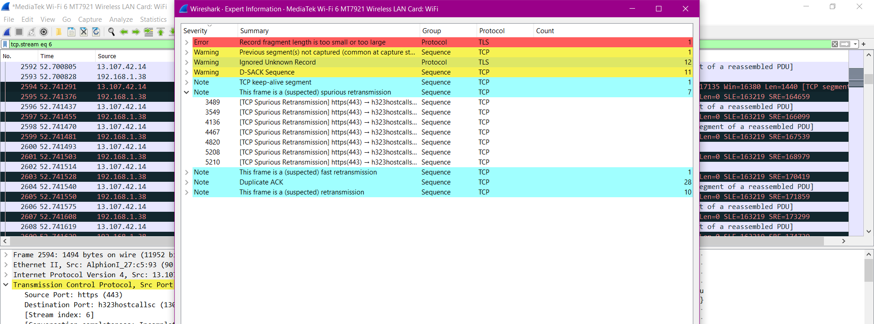
We can see the spurious retransmission of frames from the expert system menu

Slide 44
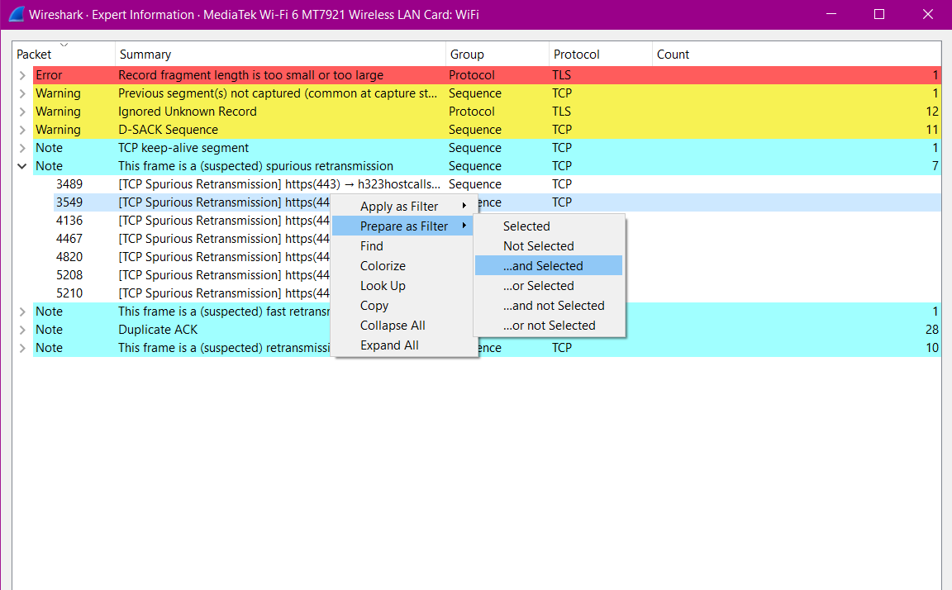
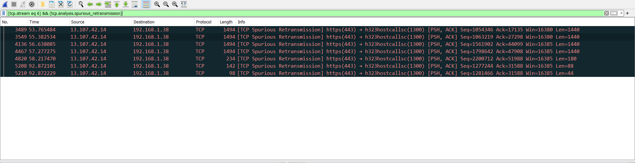
We can select the retransmitted frames alone

Slide 45
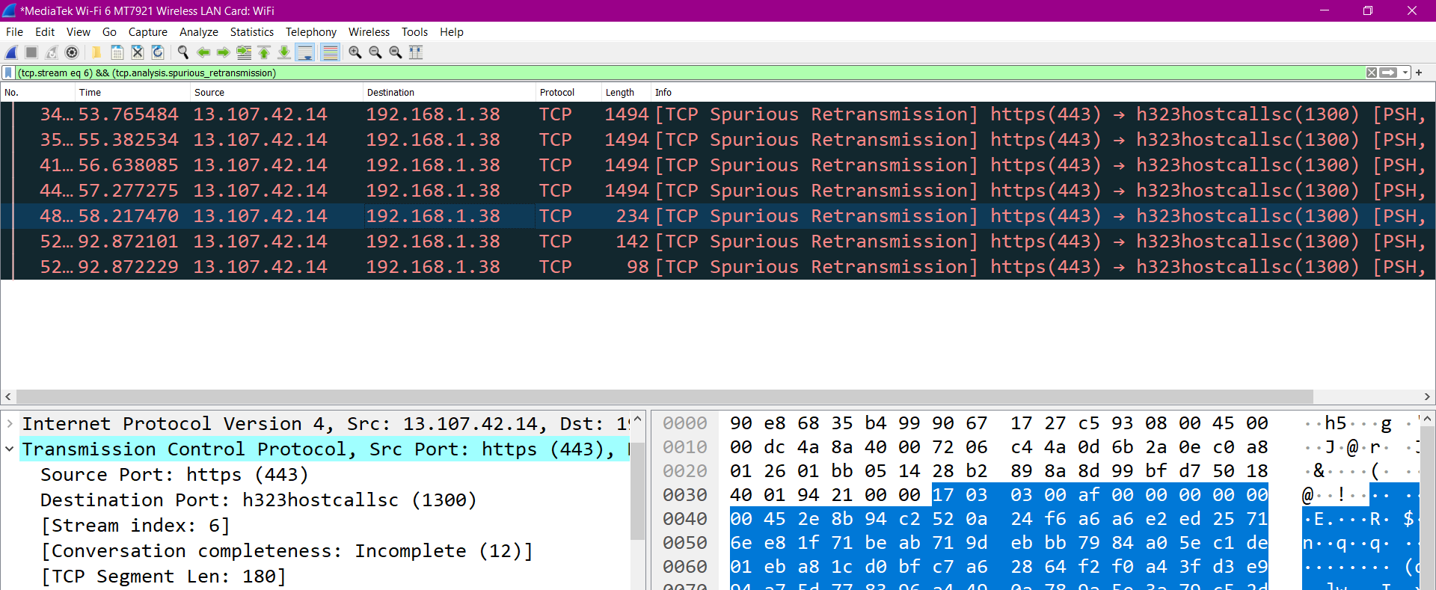
The Source Port(443) HTTPS is retransmitting the packets from the server

Slide 46
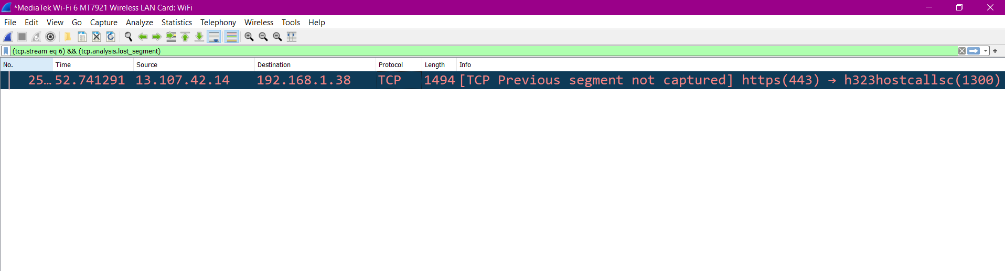
This shows the lost segment packet from the above packet

Slide 47
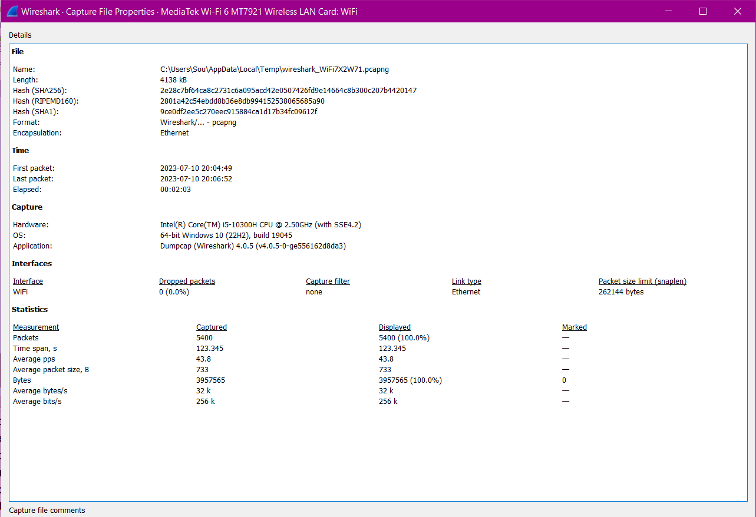
We can view the Statistics of the captured file properties of a capture

Slide 48
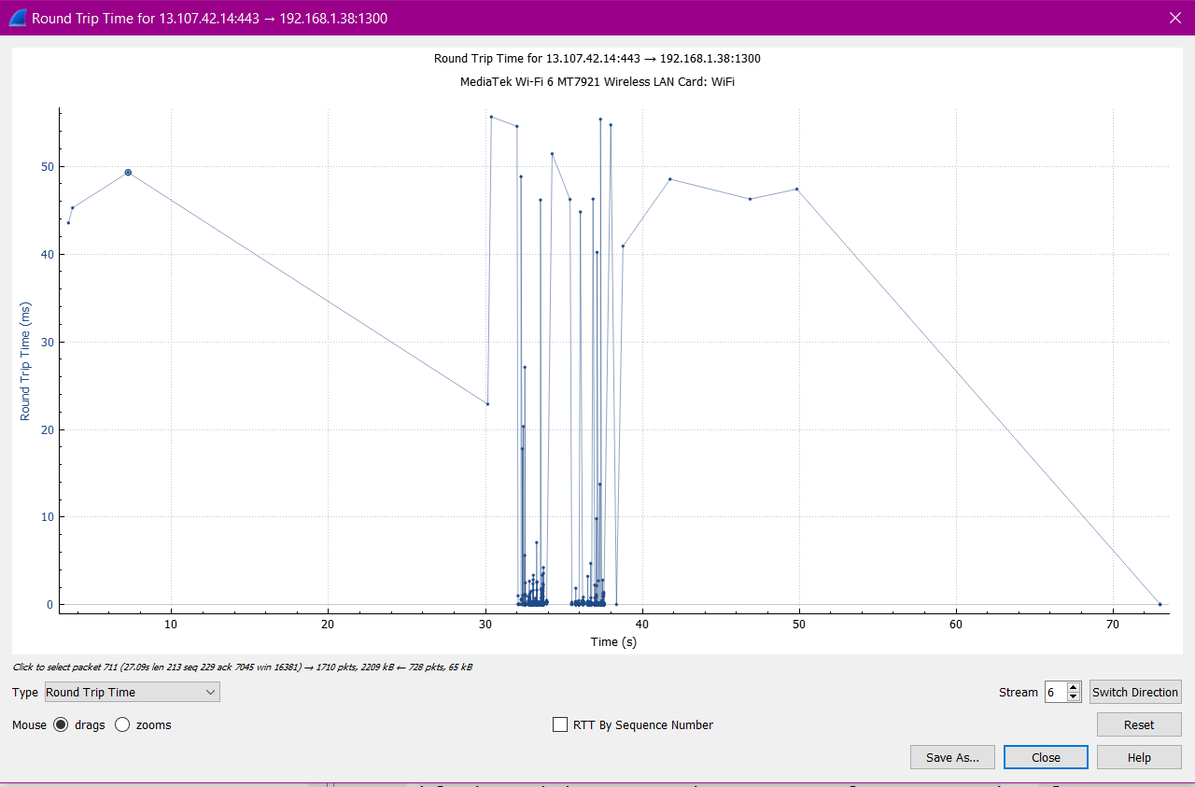
Round trip time(RTT) measures the time it takes to travel from client to server and then back

Slide 49
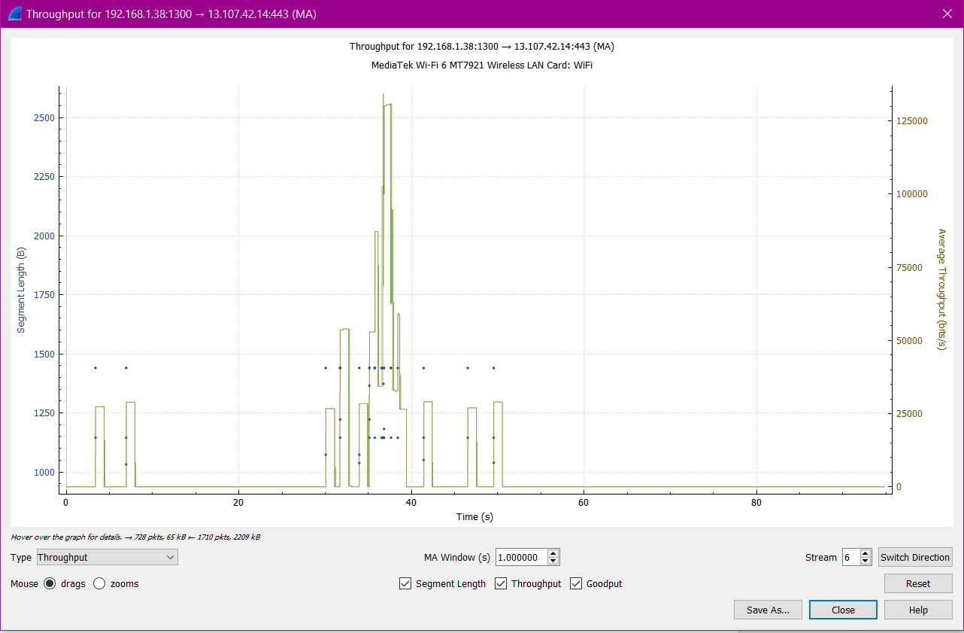
Throughput graph

Slide 50
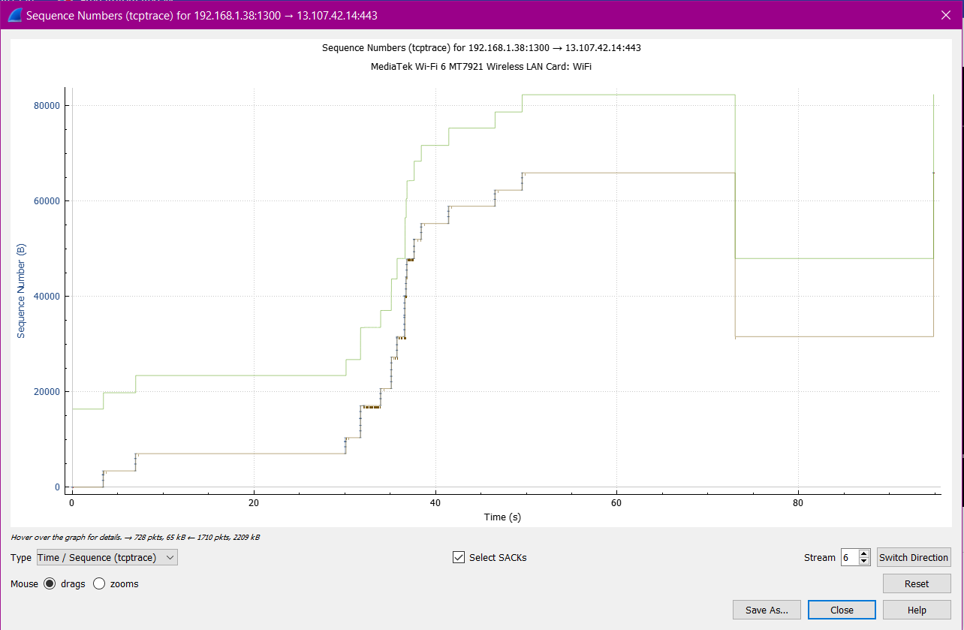
Time Sequence for tcptrace

Slide 51
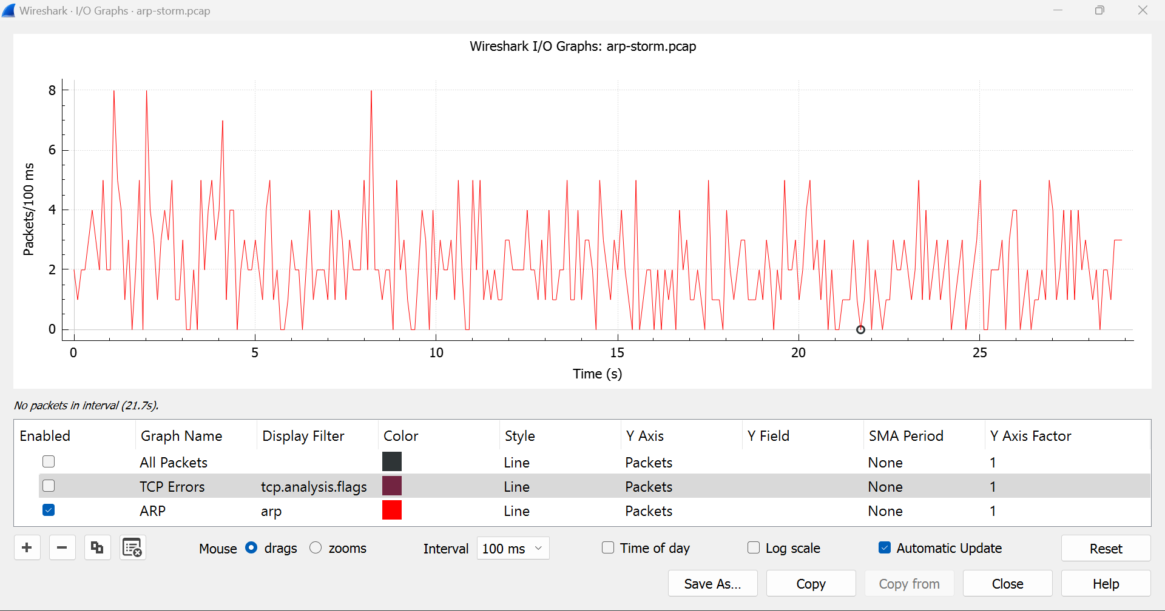
Spotting an ARP STROM

Slide 52
An ARP Strom or ARP Flood can degrade the Network. We should investigate it further.
It could be the reason of a Hardware misconfiguration or it can also be the cause of an Attack, that if once launched will keep generating ARP broadcast packets.
ARP Flooding could be the result of Malware.
An ARP Flood Attack it will only affect a single subnetwork as an ARP Broadcast don’t pass through the router

Slide 53
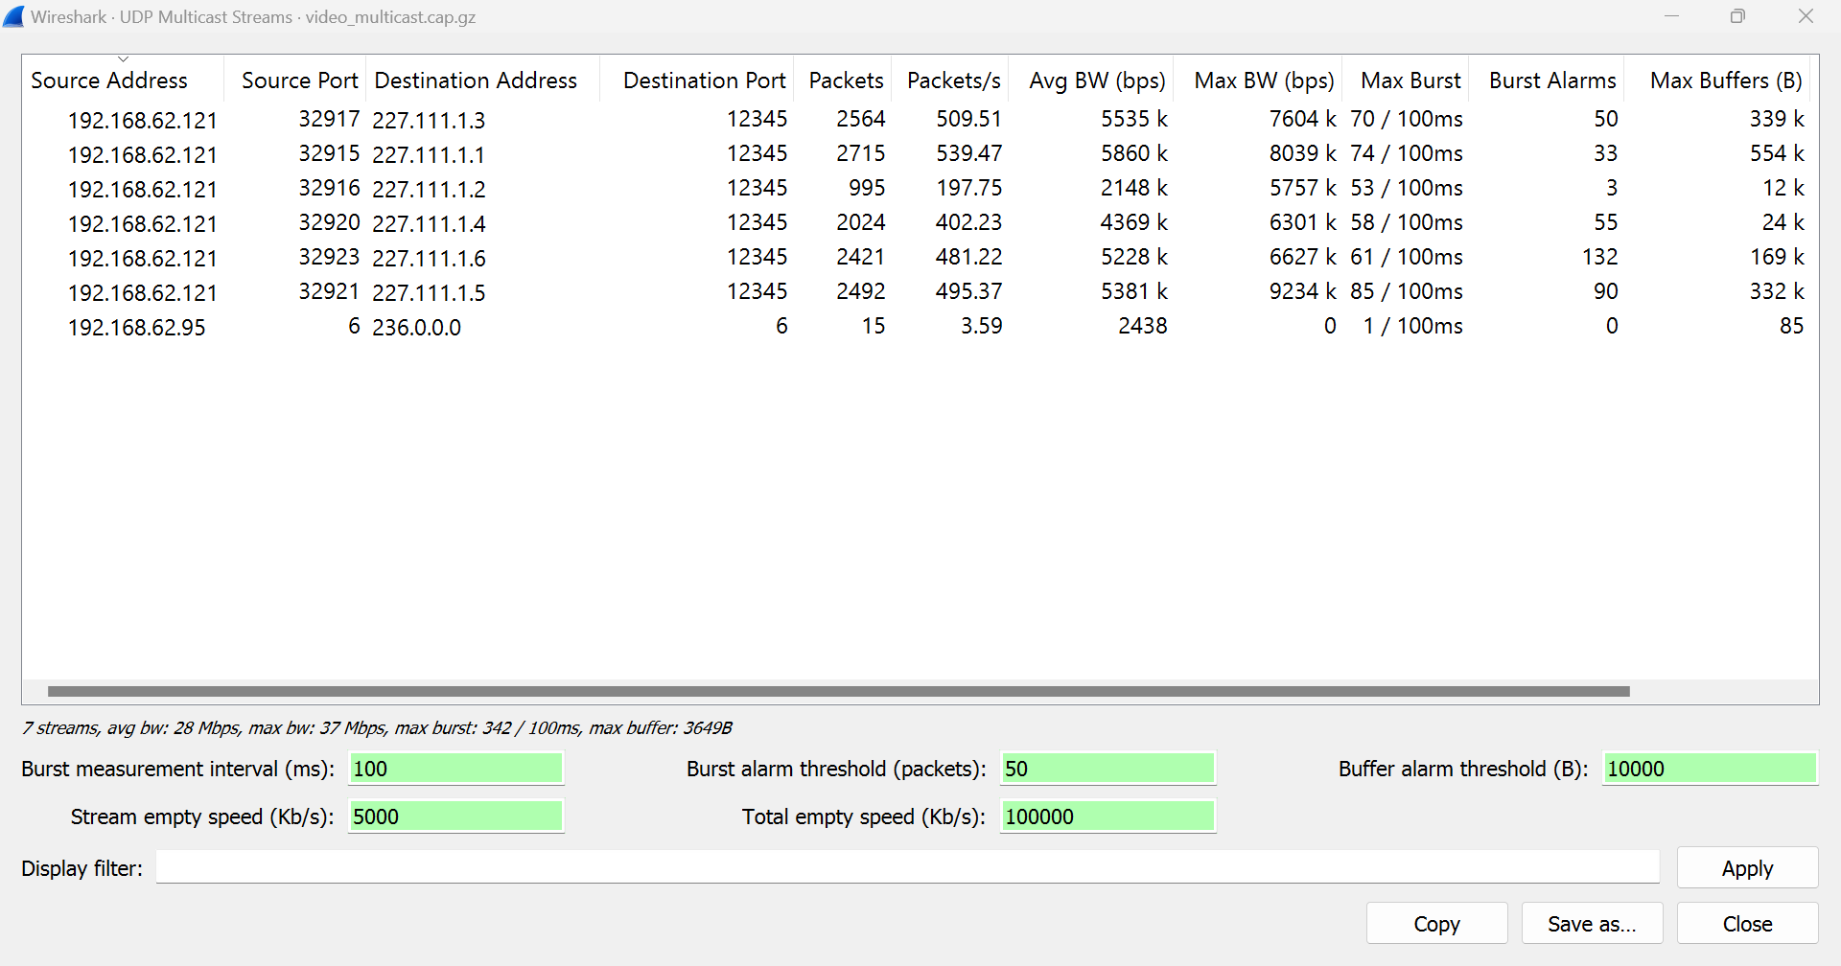
Identifying Bursty Traffic

Slide 54
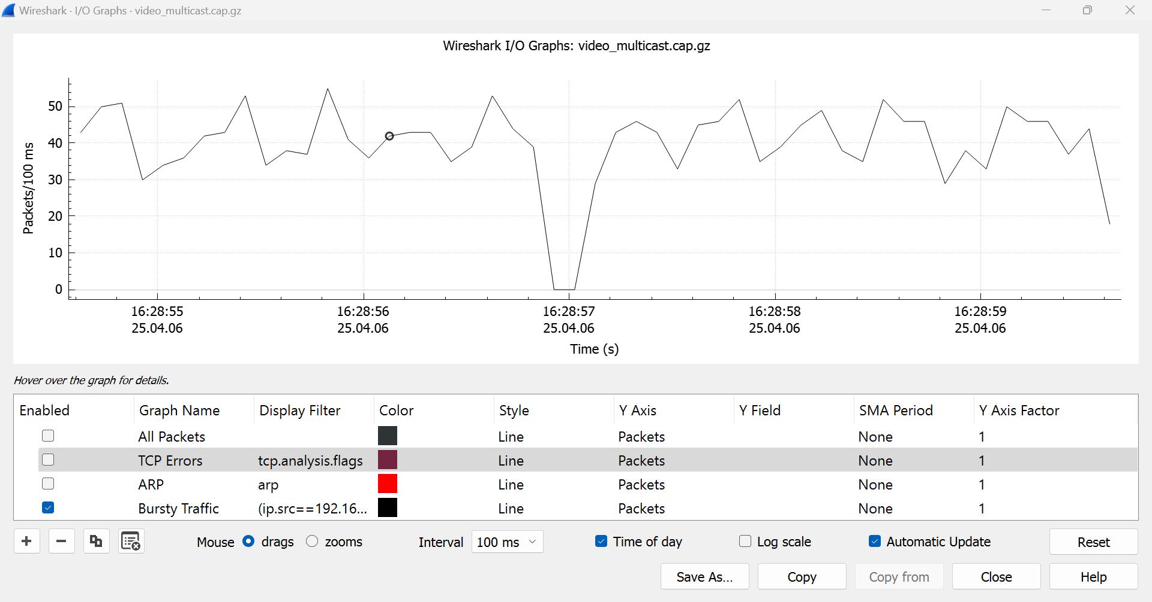
As we can see the traffic was going along and there was an output drop as evidenced here at the time 16:28:57 second. Even small bursts can temporarily disrupt the flow. For example, while you are gaming

Slide 55
Protecting from Packet Sniffing
It can expose sensitive information, as long as we keep browser updated it will protect us.
In the browser privacy and security, it tries to block social media trackers, cross-site tracking cookies.
When you log in to some websites it will warn you if the connection is secure or not.
I know that if I enter my username and password it will be encrypted by using transport layer security.
MACOF Attack
On a switch there is a MAC Address table or CAM(Content Addressable Memory) Table.
A macof attack can flood this table and overwhelm the switch with 1000s of bogus entries. At that point the switch will act as Hub and allow all the traffic to flow out of all the ports.
As we can see a number of different IPv4 addresses & some of them aren’t legal to use such as multicast and private IP addresses.

Slide 56
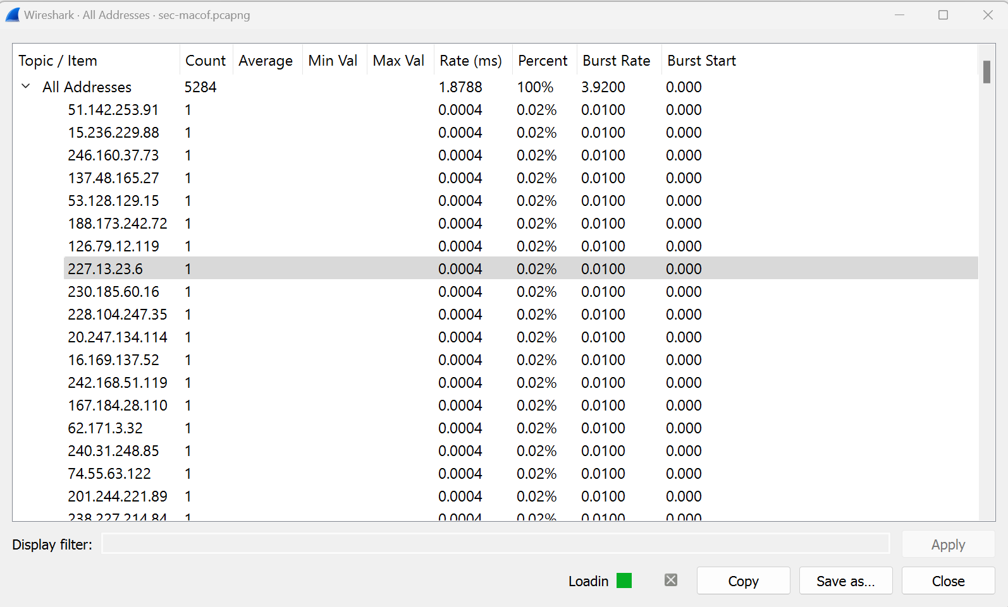
But it doesn’t matter as the attacker sets up their software and it just throws bogus IP addresses & MAC addresses onto the network.

Slide 57
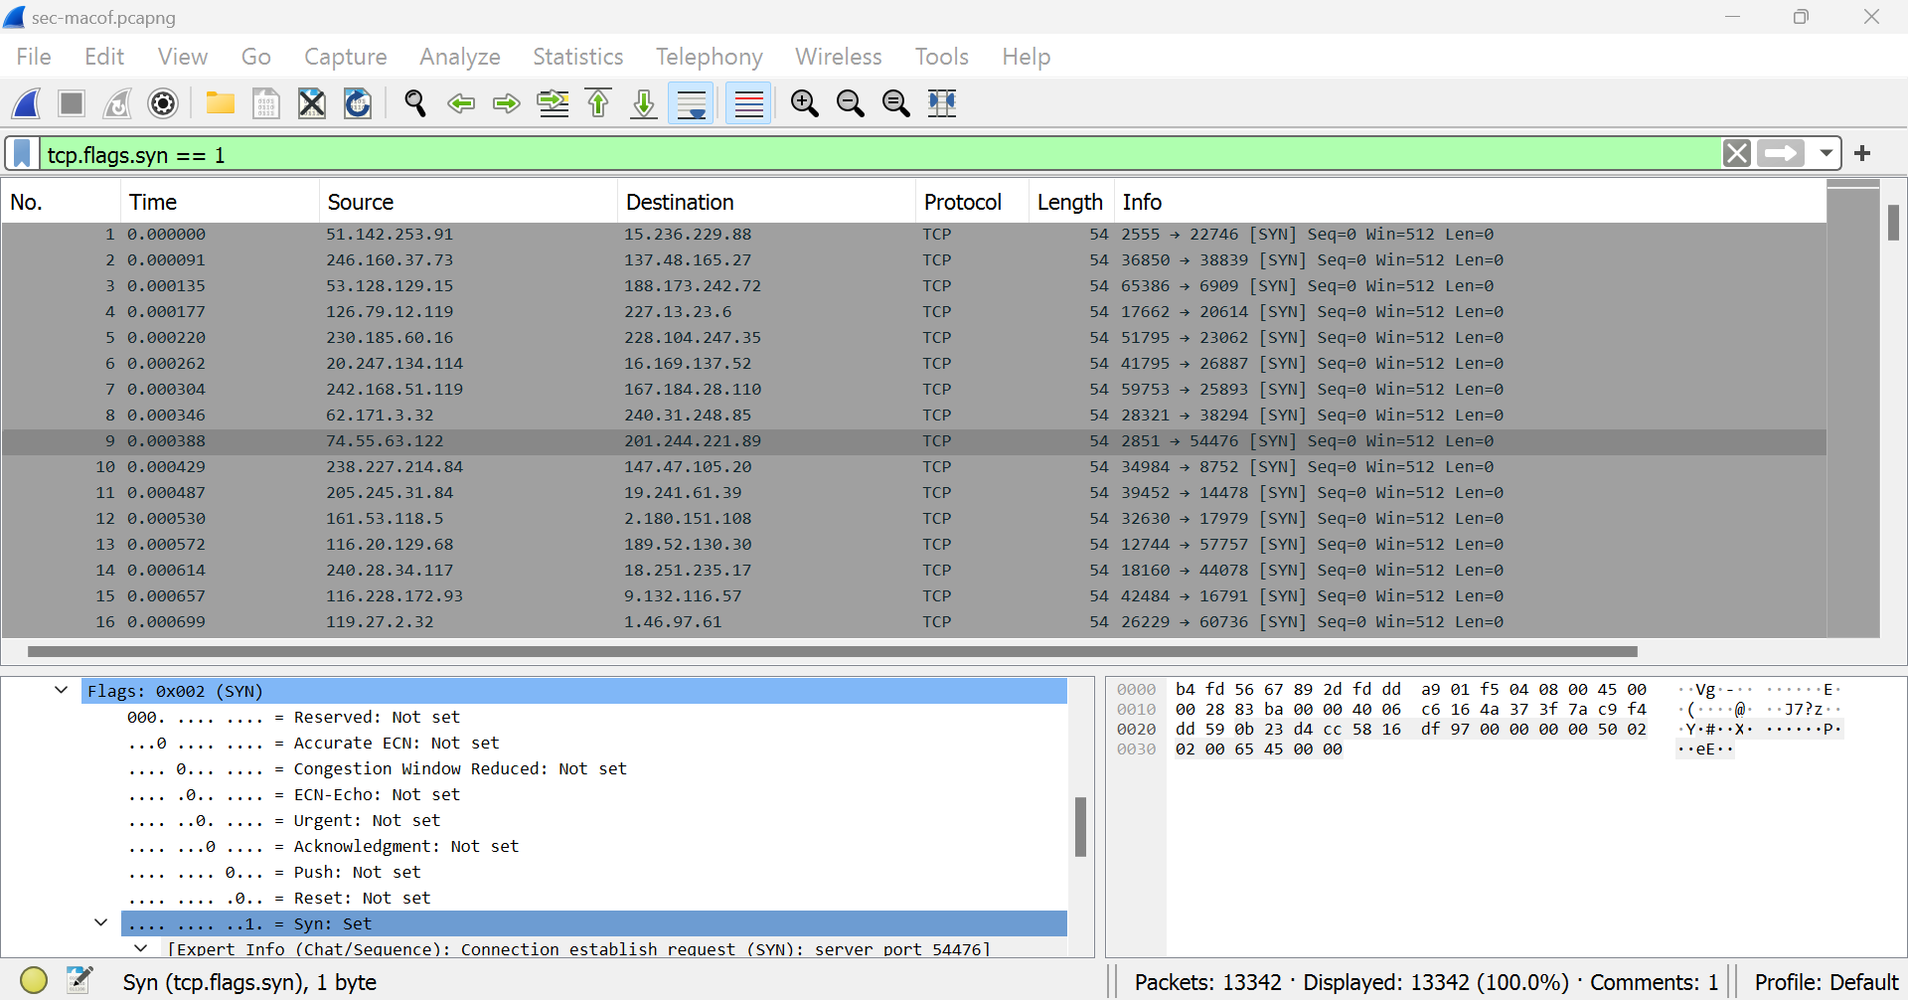
There are many SYN(synchronize packets) packets transferred in the capture filter. But, are there any acknowledgements ?

Slide 58
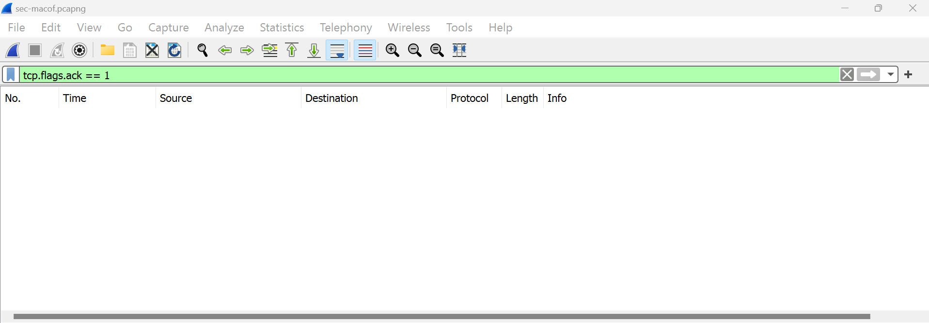
When we type tcp.flags.ack == 1 in the display filter there are no acknowledgements.
So, that’s the signature of a macof Attack.

Slide 59
Tshark
Tshark is used to run simple captures through the cmd prompt and analyse captured packets in Wireshark and can also limit to capture a particular port.
Commands:
cd ..
cd ..
cd “Program Files”
cd “Wireshark”
tshark -i “WiFi” -a duration:10 -w tshark.pcap
tshark –i “WiFi” -f “src port 53” -a duration:15 -w dns.pcap

Slide 60
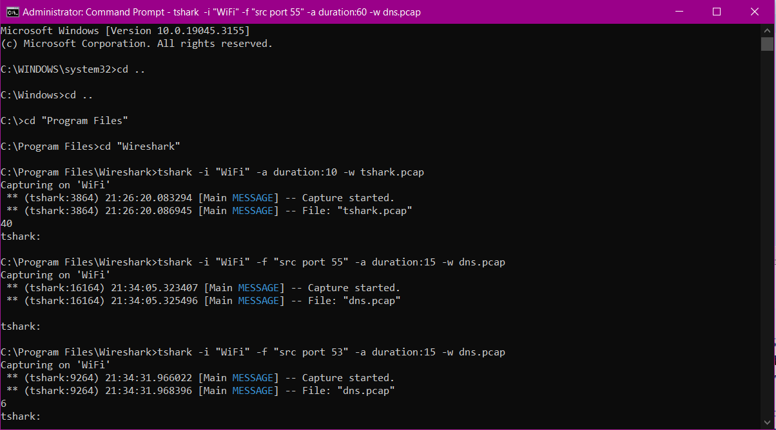

Slide 61
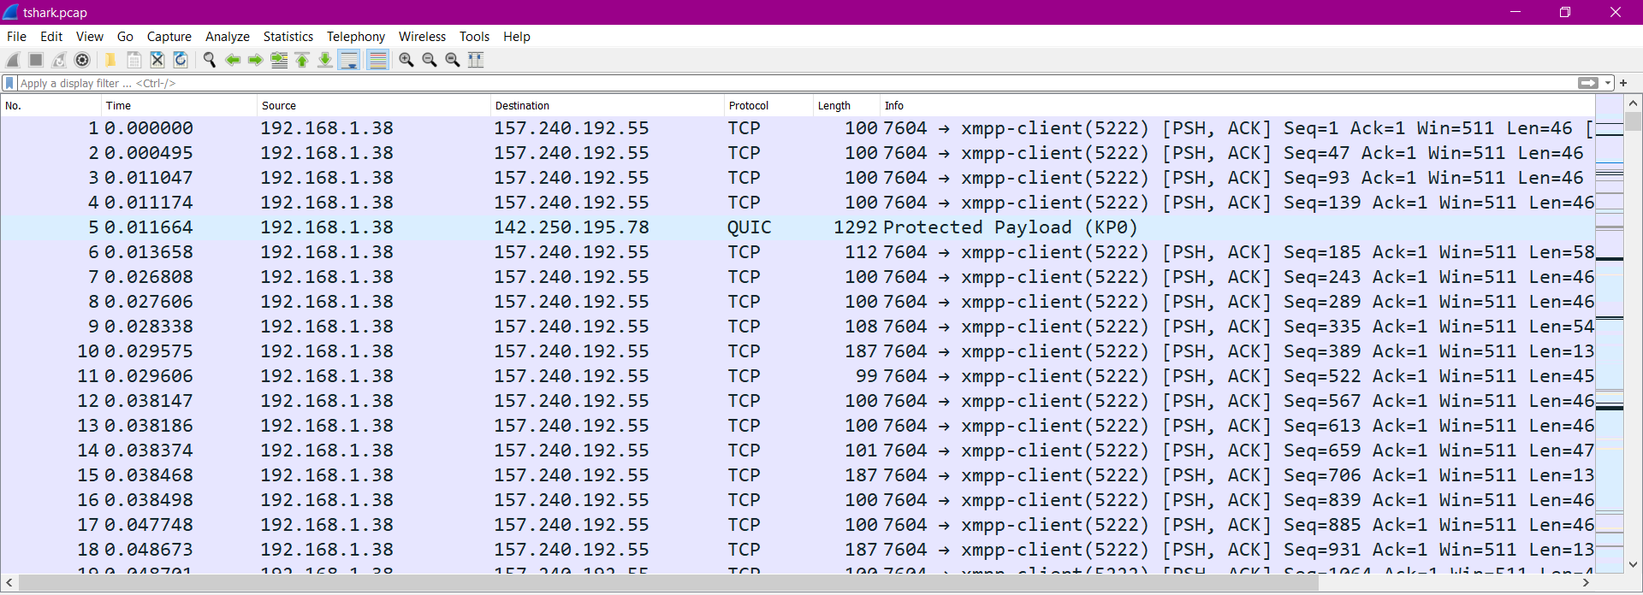

Slide 62
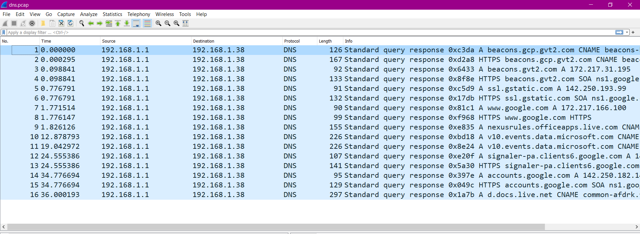
Here, only the dns port(53) has only been filtered through the traffic captured

Slide 63
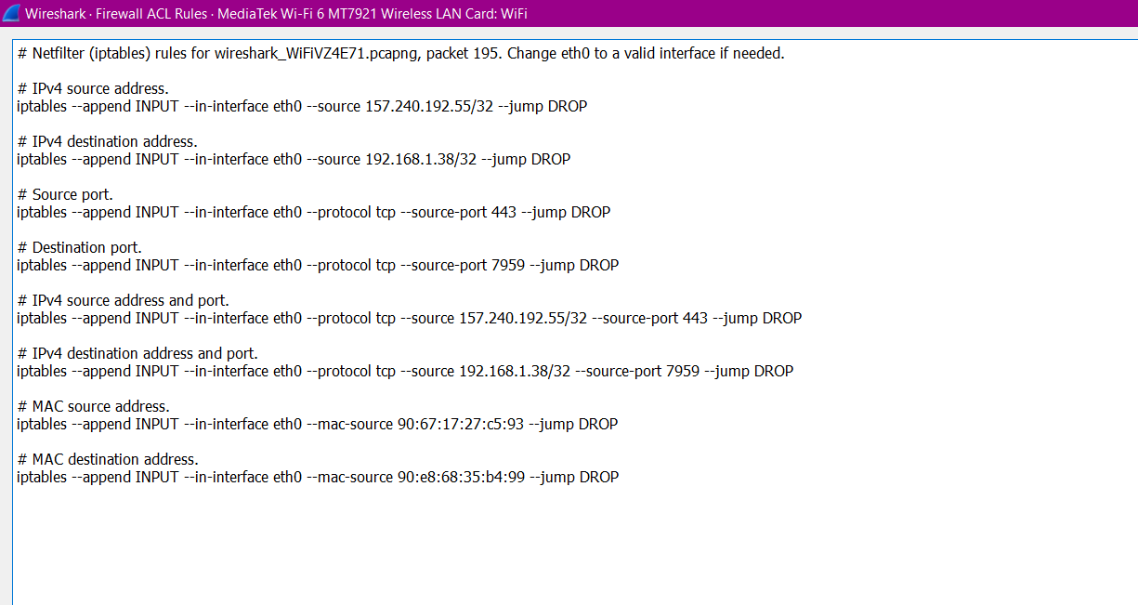
Creating Firewall Rules
If we would like to stop any traffic coming from 192.168.1.1

Slide 64
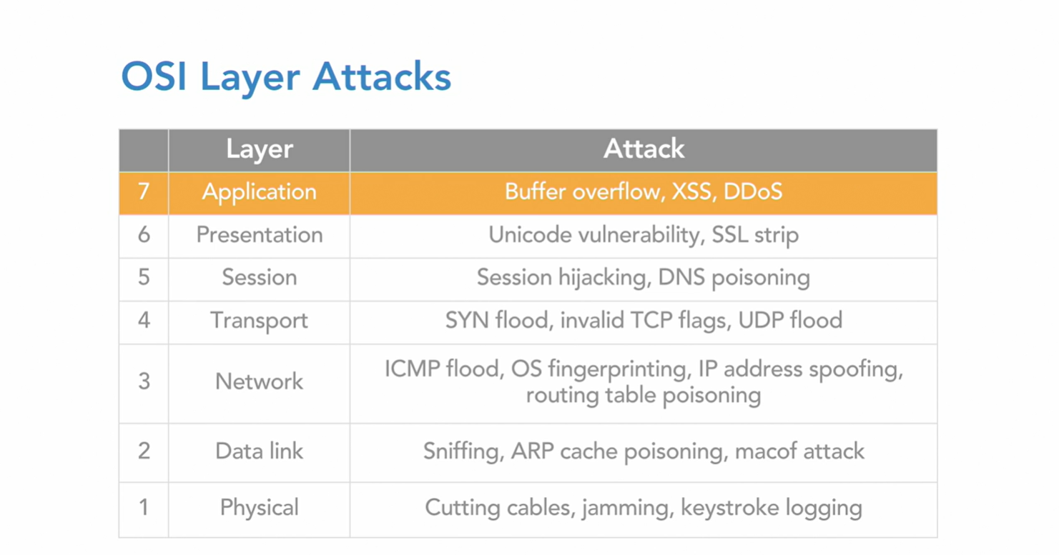
Types of OSI Layer Attacks

Slide 65
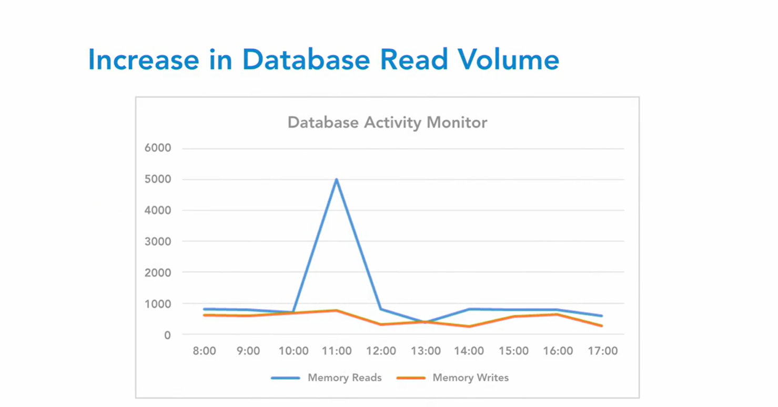

Slide 66

Investing Attacks
1.Brute Force Attack Identification
As we can see there are many password attempt requests in the system, after I have filtered only the ftp request command from a capture.

Slide 67

Fast Flux DNS

Slide 68

This Fast Flux DNS uses a 60 sec TTL value and has different host address for the same site.

Slide 69

Trojan Activity

Slide 70


Slide 71


Slide 72


Slide 73

Unwanted TOR Activity
From the TOR pcap capture we have analysed the UDP Conversations of file. We can see that the system had an unusual port 9001.

Slide 74

From the below website, we can get the information that Port 9001 is used for TOR network activity.
https://www.speedguide.net/port.php?port=9001
TOR uses HTTP and SSL ports to act as a genuine service to hide their activity from the user.

Slide 75


Slide 76


Slide 77



